Slide 1
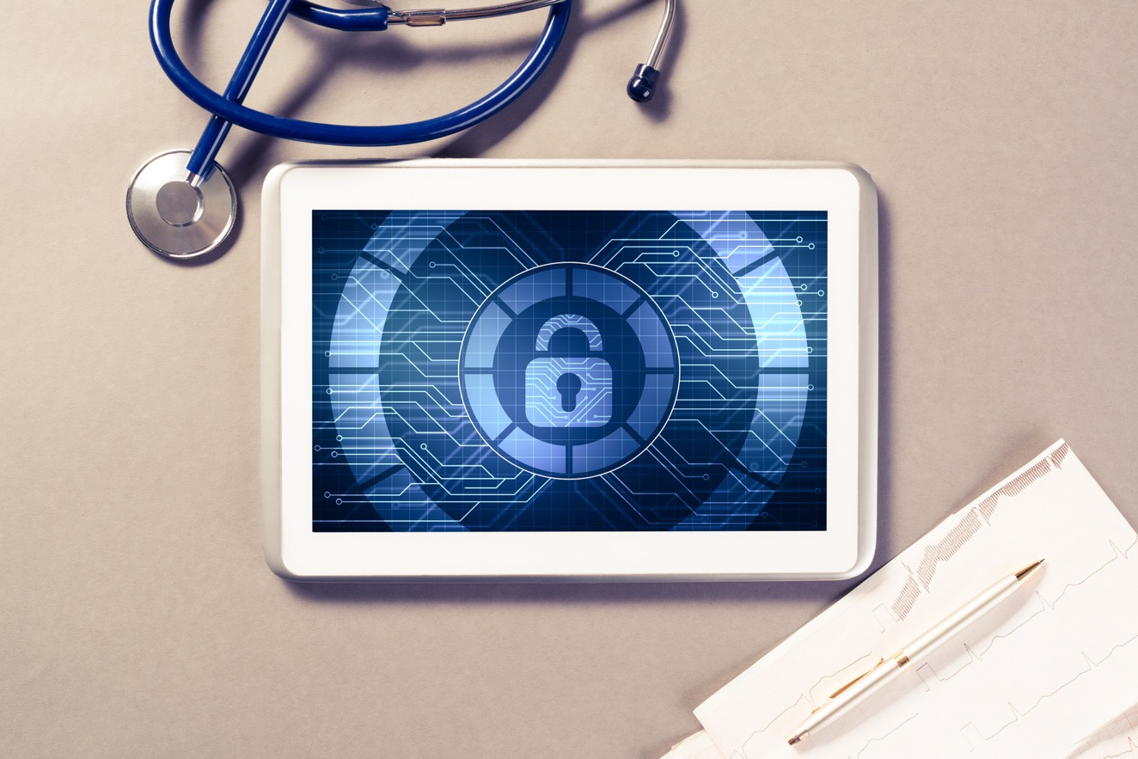
Network Connected Medical Device Security

Slide 2
Welcome Network Connected Medical Device Security
OUTLINE
Medical Devices and Security
Statistics
Impacts to Healthcare
Risk & Vulnerabilities
Lessons Learned
Notes:
Welcome to this presentation on the topic of Network Connected Medical Device Security. Over the next 30 minutes you will be presented with an overview of the following topics:​
​
Medical devices and their connection to the internet; how things have changed over the year​
Recent statistics regarding impacts to healthcare and cyber risks, particular with connected devices​
And why cybersecurity awareness is important to you as an individual and to patient safety as well.​
​
​The learning objectives include:​
​
Exploring the world of medical device security in today's healthcare system​
Understanding the risks associated with connected medical devices​
Articulating the critical role you play with patient safety.​
​
​We will include a couple of Knowledge Checks along the way and lessons learned to close the session.
At the end of this course is a link that will direct you to complete your Certificate of Completion for this training. Let’s begin!​
​

Slide 3
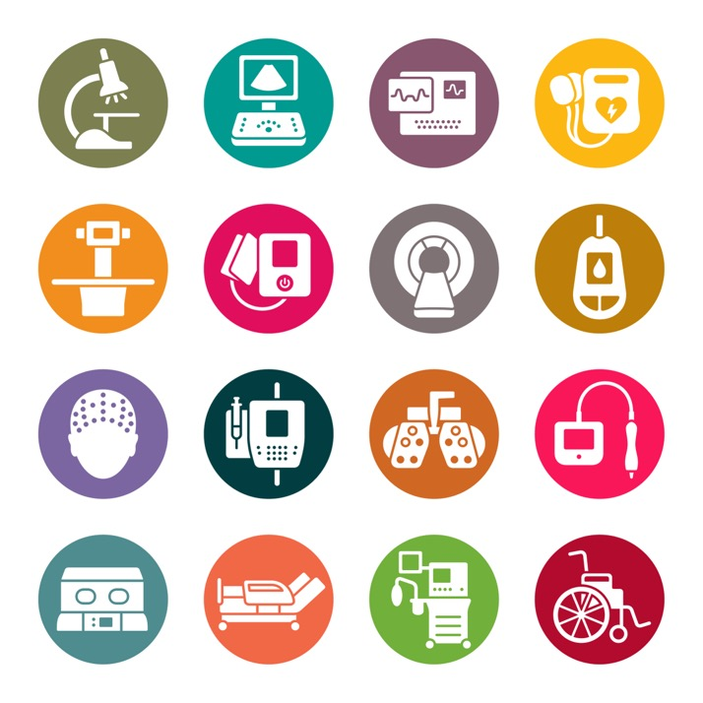
Medical Devices
Essential tools that provide diagnostic, therapeutic, and treatment services.
As technology advances, the complexity and sophistication of these devices follows.
Automating = reduction of manual data entry and exposure to human errors.
The medical device benefits are accompanied by cybersecurity challenges
Notes:
Narrator:
Let’s start this conversation about medical devices in general.
Medical devices have been around for decades and are essential tools for providing diagnostic, therapeutic and treatment services. As technology and healthcare begins to migrate to these digitized systems, so to the complexity and sophistication of medical devices​.
Automating data collection from medical devices reduces the manual burden and potential exposure to human error from the manual input of data. While there are many benefits associated with these connected medical devices, they are not without increased cybersecurity risks.

Slide 4
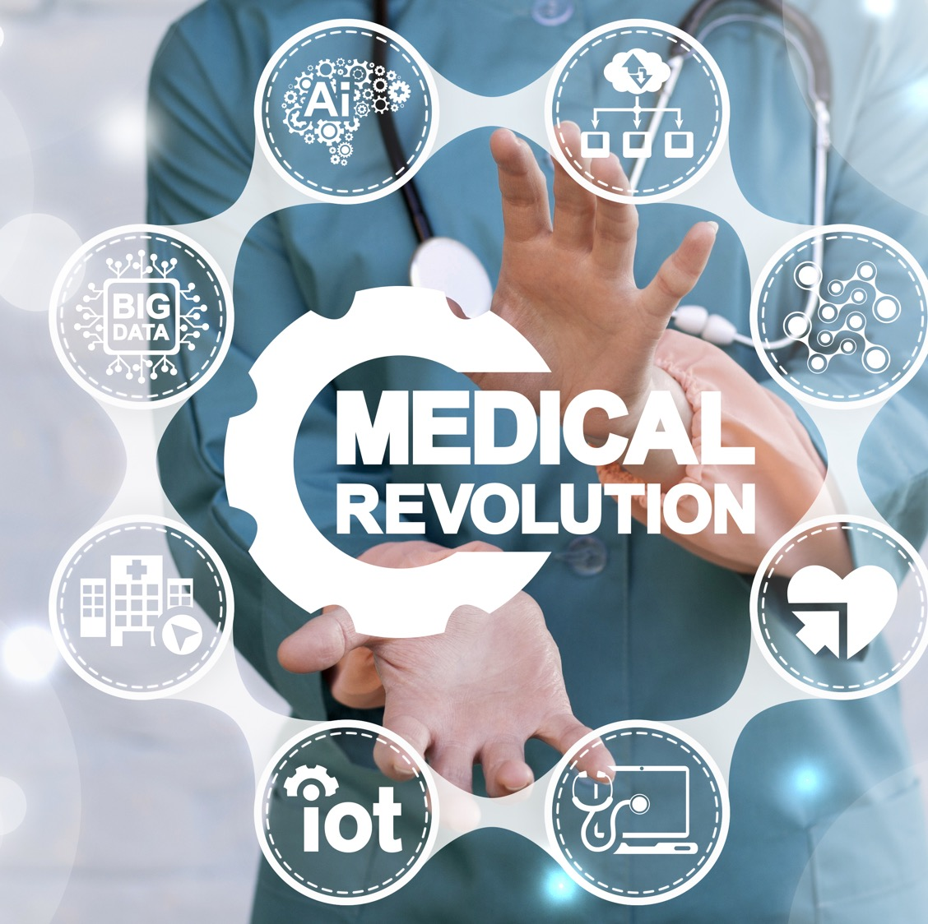
Healthcare IoT
“Internet of Things”
MRI Machines
IV Pumps
Heart Monitors
Glucometers
Notes:
Narrator:
What is Network Connected Medical Devices? These are Healthcare IoT (Internet of Things) devices that have medical functionality. Examples abound in any hospital: MRI machines, IV pumps, heart monitors, glucometers.
Infusion pumps were by far the most common connected device in hospitals, accounting for 12 percent of all connected devices, and 38 percent of all IoMT devices detected
According the 2022 State of Healthcare IoT Device Security released by the Cynerio Research company, many of the devices on this list didn’t have internet connections a decade ago but going forward they almost always will.

Slide 5

Real-World Scenario
A cyber-attacker gains access to a care provider’s computer network and takes command of a file server. While scanning the network for devices, the attacker takes control (power off or reboots) all of the heart monitors in the intensive care unit (ICU) putting multiple people at risk.
Notes:
Narrator:
Read slide as written;
This is the risk associated with network connected devices, this is what we need to be aware of and be prepared for. Then read slide

Slide 6

Knowledge Check #1
True or False?
There are increased cybersecurity risks to patient safety with network connected medical devices.
Notes:
Let’s Review
Here is your first Knowledge Check:

Slide 7
Answer to Knowledge Check #1
Now, let’s look at
The correct answer is: TRUE!
Yes, anytime we connect a device to the internet,
we expand the footprint of potential associated cyber risks.
Notes:
Narrator:
The correct answer is: A
Read slide as is

Slide 8
Over 500 healthcare breaches in 2021
US Department of Health & Human Services (HHS
Ransomware attacks on hospital increased to 123% in the past year
2021 Sonic Wall Cyber Threat Report
Ransomware cost hospitals nearly $21B last year
Comparitech
The percentage of healthcare breaches caused by connected devices is equal to the percentage of healthcare breaches caused by phishing
Ponemon Research Report on Healthcare During Covid-19 and Beyond
The average hospital loses $8M per ransomware incident and takes 287 days to fully recover
Emsisoft Report: The state of Ransomware in the US
The Healthcare IoT Cybersecurity Landscape
Cynerio 2022 Report
Notes:
Narrator:
So, let’s look at some of the data and the risks and threats.
There is a lot of information on this slide and each number represents impacts to healthcare and patient care. Just look at the first box – According to “The State of Healthcare IoT Device Security 2022 Report, HHS reports in 2021 there were 500 healthcare breaches.
And the percentage of healthcare breaches caused by connected devices is equal to the numbers caused by phishing! WOW that is an interesting fact!

Slide 9

Any vulnerability could have a serious impact
Default passwords are not changed on the connected device since received from the vendor is a vulnerability
Patient safety may be compromised due to a potential system or network cyber-attack i.e.. breach
Notes:
Narrator:
These are examples of vulnerabilities that could have a serious impact to patient safety overall and the healthcare systems within your organizations.
Default passwords that are not changed on the connected medical device since received from the vendor
Compromised patient safety due to a potential system or network cyberattack like a breach for example

Slide 10
Any vulnerability could have a serious impact
If the network connected device succumbs to an attack, broad hospital impacts could occur due to the unavailable use of connected devices for patient care
In some instances, devices are connected to a network managed by a third party vendor, which increased the potential for a cyber-attack.
Notes:
Narrator Read as outlined on slide
These could also have a serious impact to patient safety with connected devices.

Slide 11
Quick tips to be better prepared
Do you know your organization’s policy regarding notifying patients if their network connected medical device been compromised?
How do patients notify us if their device is compromised
Are the network connected devices kept up to date and protected against compromise?
Do you know who to contact in the event of an attack or shutdown?
Notes:
Narrator:
Now that we have reviewed all the technology and stats around cyber risks, lets talk about what you can do to be better prepared.
Know your organization’s protocols in case of a potential shutdown or attack against connected medical device
Help patients and staff by understanding the processes and procedures; this can help mitigate the impacts.
Be sure to ask:
Do you know your organization's policy regarding notifying patients if their network connected medical device has been compromised?
How do patients notify us if they suspect their connected medical devices are compromised?
Are connected medical devices kept up to date and protected against compromise?
Know who you need to contact in the event of an attack or shutdown.

Slide 12

Knowledge Check #2
Please select the correct answer to the following question:
Which of the following are helpful tips when it comes to network connected medical devices:
Know who in your organization you should contact for assistance
Know your organizations procedure to contact patients in the event of a compromise
Know the steps to keep your devices up to date or who to contact to ask those questions.
All the above.
Notes:
Narrator:
Knowledge Check #2
Read as is

Slide 13

Answer to Knowledge Check #2
The correct answer is:
D - all of the above!!
Notes:
Narrator:
The more information you have regarding policies and next steps, the more prepared you will be in the event of a cyber attack.

Slide 14
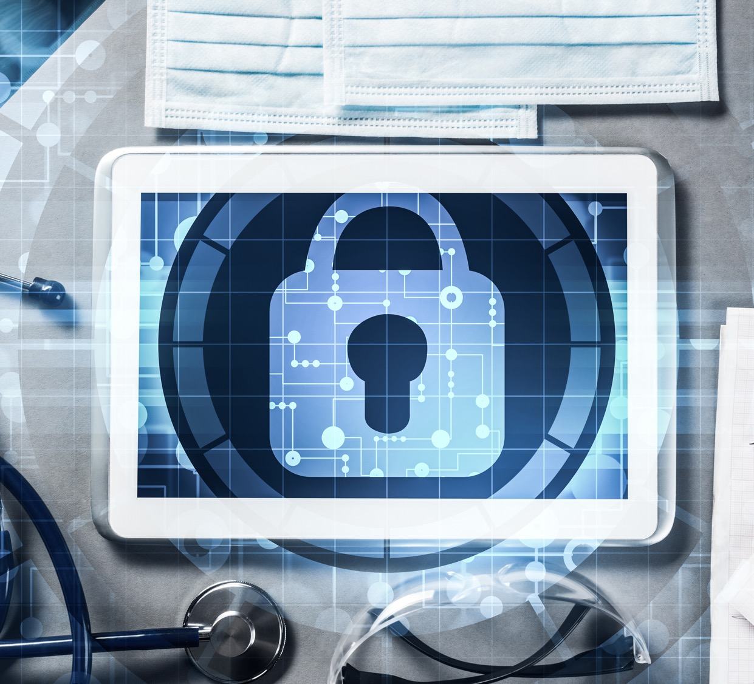
Lessons Learned
Medical devices deliver significant benefits and are successful in treatment therapies and patient care.
They reduce the potential of human error with manual recording of patient data.
As with all technology, medical device benefits are accompanied by cybersecurity risks.
Be cyber-aware! Know who to contact if you suspect a cyber attack or any abnormality with your medical devices.
Notes:
Narrator:
In summary, lets review some lessons learned and key points to remember regarding medical device security and the importance of being cyber safe!
Medical devices deliver significant benefits and are successful in treatment therapies and patient care.
They reduce the potential of human error with manual recording of patient data.
As with all technology, medical device benefits are accompanied by cybersecurity risks.
Be cyber-aware! Know who to contact if you suspect a cyber attack or any abnormality with your medical devices.

Slide 15
FDA
U.S. Food & Drug Administration
For a deeper dive into the subject of connected medical devices, select the link below to view a YouTube video done by the FDA.
FDA: Cybersecurity Awareness for Connected Medical Devices
Notes:
Narrator:
Read slide as it: the link will take you to a youtube video for more detailed information on this subject.

Slide 16
Congratulations! You have completed this session on Network Connected Medical Device Security.
In this video you’ve learned:
The role of network connected medical device security in today's healthcare system​
Understanding the risks associated with connected medical devices​
The important role you play with patient safety and network connected medical device security.
​
We all play a key role in keeping our organization safe. We are the first line of defense so always remember:
CyberSafety is Patient Safety!
Notes:
Narrator:
Read slide as is, provide direction to navigate to completed the Certificate of Completion per your organization policies/procedures.

Slide 17
