Slide 1

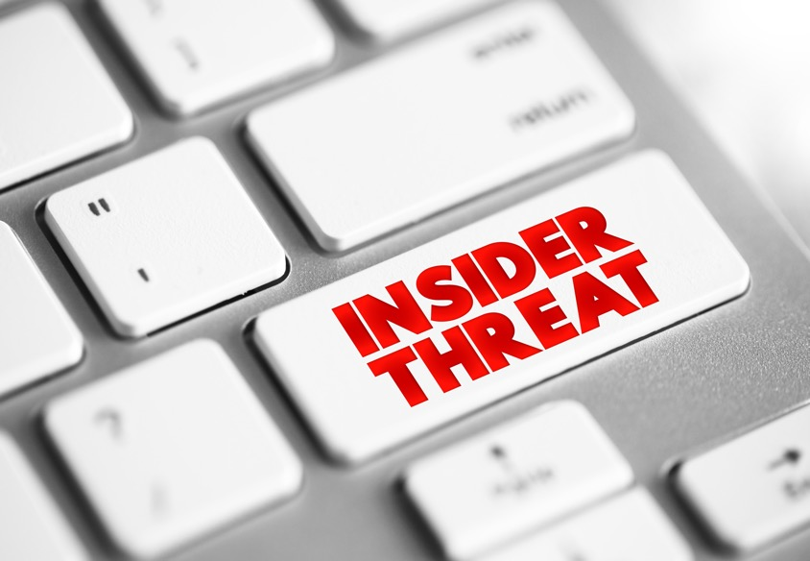
Insider Accidental, or Malicious
Data Loss

Slide 2
Welcome
Insider, Accidental, or Malicious Data Loss
OUTLINE
What is Insider, Accidental or Malicious Data loss?
Statistics
Impacts to Healthcare
What you can do
Knowledge Checks
Lessons Learned
Notes:
Narrator:
Welcome to this presentation on the topic of Insider Accidental or Malicious Data Loss. Over the next 30 minutes you will be presented with:
An overview of what we mean by Insider Accidental or Malicious Data loss
Why this is so important to you organization and the impacts to healthcare in general.
Your role
Knowledge Checks
And we will conclude best practices and lessons learned.
Let’s begin!

Slide 3


“An insider threat in the HPH Sector is potentially a person within a healthcare organization, or a contractor, who has access to assets or inside information concerning the organization's security practices, data, and computer systems.”
Department of Health & Human Services, 4/21/22
Notes:
Narrator:
On April 21, 2022, the Department of Health and Human Services (HHS) shared a statement that is in alignment with what the Protenus 2022 also stated. They issued a warning regarding insider threats when it comes to the healthcare and the public health (HPH) sector.
Read quote as is -

Slide 4
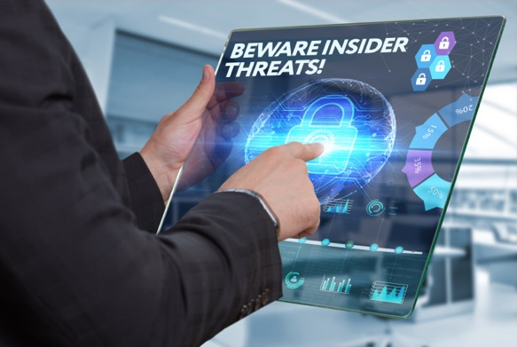
Insider Threats Defined: Who, What, Why?
Involve people in the organization who have legitimate access to your computer systems and network.
Negligence or malice causes these insiders to compromise your patient and enterprise data
Repercussions for patients, security and overall quality of care.
Accidental Insider Threat
Honest mistake
Perhaps tricked by a phishing email containing an embedded link, which then sends the email information to an unknown source.
Intentional Insider Threat
Malicious loss or theft to organization network, infrastructure or database with an objective of personal gain or inflicting harm to a person or the organization.
Notes:
Narrator:
What do we mean when we talk about “insider threats”? What do I need to know about this as an employee?
Let’s begin with a clear definition of the roles and meaning behind our topic for today.
Insider threats usually involve people in your organization or company that have legitimate access to your computer systems and network. Whether through negligence or malice, these insiders can compromise your patient and enterprise data over short or longer periods of time. This has serious repercussions for the patients, their security, and overall quality of care delivered.
Insider threats exist within exist within every organization where employees, contractors, or other users access the organization's technology infrastructure, network, or databases.
There are two types of insider threats: accidental and intentional.
An accidental insider threat is unintentional loss caused by honest mistakes, like being tricked, procedural errors, or a degree of negligence. For example, mishandling data sending it out to an unauthorized party by mistake is an accidental insider threat
An intentional insider threat is malicious loss or theft caused by an employee, contractor, other user of the organization’s technology infrastructure, network, or databases, with an objective of personal gain or inflicting harm to the organization or another individual. These threats may be harder to identify because they could be the usual people you work with everyday.

Slide 5
87%
Percentage of Breaches caused by hackers and insider threats
$4.61 Million
Dollars
Notes:
Narrator:
Here is an alarming statistic as reported by the 2022 Breach Barometer report on healthcare. What does that percentage represent? That’s a high percentage.
Could be good or not right?
Hit animation…
The report states that 87% of reported breached cases were caused by hacker or “insider events”. The average total cost of a breach caused by insider threats is 4.61 million dollars.
Time for a deeper dive into this research.
2022 Breach Barometer Report IBM

Slide 6
Protenus Report 2022
Insider threats have increased across all three insider profiles
Careless or negligent employee or subcontractor
A criminal or malicious insider
A credentialed thief
Notes:
Narrator:
According to the recently released Protenus 2022 Breach report on healthcare, these are the facts. Although often difficult to quantify, we know that insider threats present a complex and costly set of challenges to any organization. And they can’t be ignored.
Narrator, read the top 3 insider profiles.
Which of these three on the list do you think is the root cause of most incidents?.

Slide 7

The most prevalent of the three insider threats?
Careless or negligent employees equally 56% of the incidents
Notes:
Narrator:.
The negligent insider is the root cause of most incidents. That 56% equals 3, 807 attacks caused by employee or contract negligence, costing an avg of $484,931 per incident.

Slide 8
Who is behind Insider Threats ?
An engineer steals and sells trade secrets to a competitor
A maintenance technician cuts network server wires and starts a fire, sabotaging operations
An intern unknowingly installs malware
A customer service representative downloads client contact information and emails it to a personal account for use when starting their own business
A database administrator accesses client financial information and sells it on the dark web
Notes:
Narrator:
As we have already defined, Insider threats exist within every organization where employees, contractors, or other users access the organization's technology infrastructure, network, or databases. This is a simple list of example that outline the “who”? Who are the individuals, the roles they might have within an organization that these insider threats be coming from?
Read the examples as is:
As we read these, its easy to see how an innocent mistake could be made. Perhaps that intern didn’t realize they shouldn’t be installing any software on their computer, they might have thought this was a helpful action? They all are here to show you this is reality in any organization – take a moment to look at this list and mentally jot down which do you think are accidental or intentional? No quiz, just your own thoughts. I’ll pause for a moment…
Narrator pause for a moment before moving to the next slide

Slide 9
How could this happen?
61 % of data breaches involving an insider are primarily unintentional caused by negligent insiders
Lack of awareness of security policies and training
Leaving an unencrypted mobile device or laptop containing sensitive data unattended, leaving the potential for loss of theft
Employee grievance against the organization
Notes:
Narrator:
We shared in the previous slide, the “who” behind these threats. And if you are asking yourself, what are the reasons or causes for data loss, here is a bit more information
In the majority of cases, the data shows that data loss related to breaches are often caused by negligent mistakes. Perhaps the person was rushed, or wasn’t as cautious as they should have been clicking on a link in an email?
In other causes, a lack of awareness or training of the policies in the workplace are a cause of the data loss.
Leaving your computer or laptop open, not locked, leaving access to critical patient information open for data loss or even left of the equipment.
And lastly, and most unfortunately, an employee who feels they have a grievance against the company for whatever reason.

Slide 10

Knowledge Check #1
Insider threats are people who:
Have legitimate access to computer systems and networks
Have relatives working in the same department
People who are in their probationary period.
None of the above
Notes:
Let’s Review
Here is your first Knowledge Check:
Read as is

Slide 11
Answer to Knowledge Check #1
The correct answer is: A
Insider threats are people who have legitimate access to computer systems and networks in the organization.
Now, let’s look at
Notes:
Narrator:
The correct answer is: A
Read slide as is

Slide 12

Six reasons to protect healthcare data
Sensitive data comprises the majority of your day-to-day duties
Transmission of sensitive data –PII/PHI
PHI is discussed, stored, processed and transmitted between information systems daily
Protecting sensitive data requires robust policies, processes and technologies
Impacts to the organization can be profound if data are corrupted, lost or stolen
Security breaches may prevent users from completing their work on time and adversely impact patient care
Notes:
Narrator: fade text sections in
6 reasons why data loss and protection is critical to Healthcare Organizations
All organizations within the health sector access, process, and transmit sensitive information, such as health information or PII. The fundamental data used in operations are highly sensitive, representing a unique challenge to the HPH sector. Most of the health care workforce must leverage these data to carry out their respective missions.
In that context, healthcare faces a growing challenge of understanding where data assets exist, how they are used, and how they are transmitted. PHI is discussed, processed, and transmitted between information systems daily. Protecting these data requires robust policies, processes, and technologies. 4Impacts to the organization can be profound if data are corrupted, lost, or stolen. Security breaches may prevent users from completing work accurately or on time, and could result in potentially devastating consequences to patient treatment and well-being

Slide 13
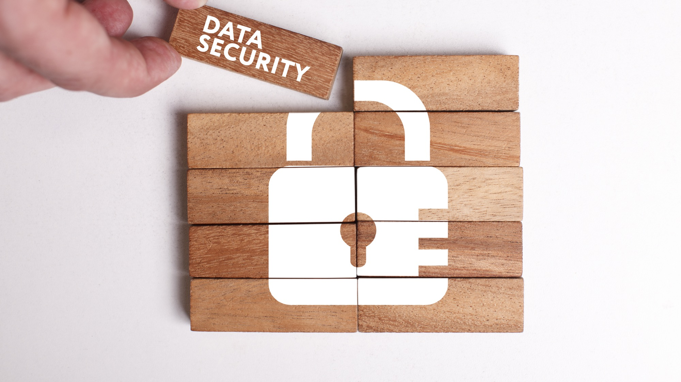
Steps to protect your data
Do not plug an unknown USB drive into your computer.
Take advantage of security features.
Keep personal and business USB drives separate.
Disable Autorun.
Use and maintain security software and keep all software up to date.
Notes:
Narrator:
How can you protect your data?
There are steps you can take to protect the data on your on any computer that you might use and awareness regarding security issues with USB drives:
Do not plug an unknown USB drive into your computer. If you find a USB drive, give it to the appropriate authorities (a location's security personnel, your organization's information technology [IT] department, etc.). Do not plug it into your computer to view the contents or to try to identify the owner.
Take advantage of security features. Use passwords and encryption on your USB drive to protect your data, and make sure that you have the information backed up in case your drive is lost.
Keep personal and business USB drives separate. Do not use personal USB drives on computers owned by your organization, and do not plug USB drives containing corporate information into your personal computer.
Disable Autorun. The Autorun feature causes removable media such as CDs, DVDs, and USB drives to open automatically when they are inserted into a drive. By disabling Autorun, you can prevent malicious code on an infected USB drive from opening automatically.
Use and maintain security software, and keep all software up to date. Use a firewall, antivirus software, and anti-spyware software to make your computer less vulnerable to attacks, Also, keep the software on your computer up to date

Slide 14

See something
Say something
Follow your instinct, and always report what does not look or feel right to you.
Beware of social engineering techniques.
Participate in regular security training sessions and if you haven’t, speak to your manager or IT administrator.
Be aware of security risks and the associated consequences of failing to comply with organizational policies. Now is the time to know all the rules, not when an incident has happened.
Notes:
Narrator: How can you help?
See something, Say something!
Intuition is a funny thing. But it’s usually accurate. Don’t ignore that gut feeling you have.
Narrator, read the bullets as is -

Slide 15
See something
Say something
Don’t be a victim, be proactive!
Always contact your Manager or IT administrator if believe you may be a victim of data loss or have made an honest mistake. Timeliness is key in reporting.
Every situation will vary so your Manager or IT security professionals will be able to guide you best because a cyber threat is not limited to just hacking.
Notes:
Narrator:
animation
Read as is 3 bullets

Slide 16

Knowledge Check #2
Data loss and data security is important but there is little I can do as an individual employee. True or False?
Notes:
Narrator:
Read Knowledge Check

Slide 17
Answer to Knowledge Check #2
The answer to the question is:
False! You are the first line of defense! And because you handle sensitive data most of your workday, being aware of unusual activity or questionable emails is key. Follow your instincts, because they are usually right.
Notes:
Narrator: Read slide as is

Slide 18
Summary
Insider threats happen at every organization. They may be accidental or malicious in nature.
Ask questions and be sure you have received all the training your organization may provide. Protecting patient safety and data is everyone’s responsibility.
These threats can cost your organization millions of dollars and potentially cause it to shut down.
See something, Say something. Contact your Manager or IT Administrator if you believe you are a victim or have made an honest mistake. Swift action can make a difference.
Notes:
Narrator:
Let’s Review! We have discussed many issues and recommendations concerning the topic of insider accidental or malicious threats. Its important to remember these closing thoughts:
Read each bullet

Slide 19
Congratulations! You have completed this session on Insider, Accidental or Malicious Data Loss.
In this presentation you’ve learned:
What is accidental vs malicious loss of data
Impacts to Healthcare and your organization
What you need to know and why your awareness and action is important.
We all play a key role in keeping our organization safe. We are the first line of defense so always remember:
CyberSafety is
Patient Safety!
Notes:
Narrator:
Read slide as is, provide direction for your organization regarding the Certificate of Completion.

Slide 20
