Slide 1
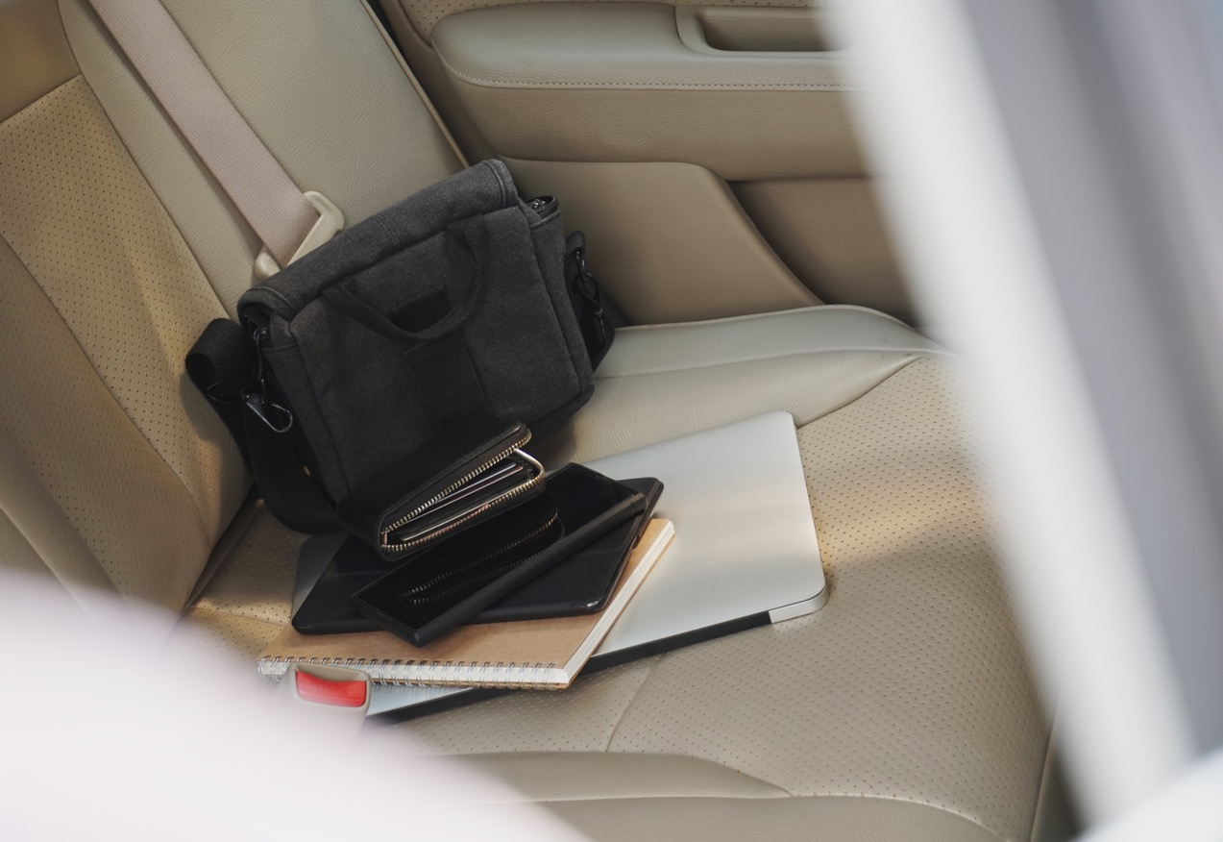
Loss or Theft of Equipment and Data
Notes:
Narrator
Welcome to 405d video on the topic of “Loss or Theft of Equipment and Data”.

Slide 2

Seconds count…
A physician stops at a coffee shop for a coffee and to use the public Wi-Fi to review radiology reports. As the physician leaves the table momentarily to pick up his coffee, a thief steals the laptop. The doctor returns to the table to find the laptop is gone. In a matter of seconds, damage is done. He sits down, in stunned disbelief at the potential impacts of what just occurred.
Notes:
Narrator
Read slide as is..this is an actual event that happened

Slide 3
Welcome
Loss or Theft of Equipment and Data
OUTLINE
Loss or theft defined
Impacts to Healthcare
What can I do?
Lessons learned
Knowledge Checks
Notes:
Narrator:
In each of the lessons of this course you will be presented with:
Overview
Discussion with examples
Lesson Scenario with Knowledge Checks
Let’s begin!

Slide 4

One laptop is stolen every 53 seconds.
70 million smartphones are lost each year, with only 7 percent recovered.
4.3% of company-issued smartphones are lost or stolen every year.
80% of the cost of a lost laptop is from data breach.
52% of devices are stolen from the workplace!
Notes:
Narrator:
Every day, mobile devices such as laptops, tablets, smartphones, and USB/thumb drives are lost or stolen, and they end up in the hands of hackers. Theft of equipment and data is an ever-present and ongoing threat for all organizations
Let's take a look at these statistics, some are surprising for sure.
NARRATOR, read the stats
And when we expand the topic to include loss of data or information on all of those devices, we open up an expansive additional risk. Cybercriminals do both – they steal the physical device and the valuable data stored on that device as well. Too often, human error is involved in the loss of equipment and the subsequent data on that device.

Slide 5

Physical Loss and Data Loss
Physical Awareness of Device
Misplace your phone
Leave your laptop or tablet unattended at work or in transit
Data Loss
Not using proper password policy
Sharing passwords
Accessing personal or unauthorized non-work internet sites on work computers
Notes:
Narrator:
How many of us, especially as it relates to mobile devices, have said “where did I put my cell phone?”
As in the example we shared at the beginning of this video, it only take a few seconds to misplace a device or let it out of your sight for a moment.
But there are other ways in addition to losing the physical device, where your data can be stolen.
A few of those are listed on the screen –
No using proper password policy? Did you update your password when prompted?
Have you given your password to someone else to access a system/program?
Have you accessed an internet site on your work computer that could be risky?
All key points to keep in mind as it relates to both physical loss and data loss.

Slide 6

Knowledge Check #1
Which of the following activities can cause data to be damaged or lost?
Staying online too long
Never fully shutting your computer down
Unauthorized access to a system
Always keeping your computer charging
Notes:
Narrator
Let’s Review
Here is your first Knowledge Check:
Read slide as is, outline each answer

Slide 7
Answer to Knowledge Check #1
The correct answer is: C
Unauthorized access to a system
Now, let’s look at
Notes:
Narrator
The correct answer is: C
Navigating to a system you are unfamiliar with poses a security risk. Is it a legitimate site? Will I be exposed to malware or viruses? These are risks we can’t afford to take so be sure you stay away from those sites you are unsure about. If you need help or additional information reach out to your Manager or IT administrator for support.

Slide 8
Data Loss How strong is your Password?
The time it takes a hacker to break your password!
Number of Characters | Numbers Only | Lowercase Letters | Upper & Lowercase Letters | Numbers, Upper and Lowercase Letters | Numbers, Upper, and Lowercase Letters, Symbols
4 | Instantly | Instantly | Instantly | Instantly | Instantly
5 | Instantly | Instantly | Instantly | Instantly | Instantly
6 | Instantly | Instantly | Instantly | Instantly | Instantly
7 | Instantly | Instantly | 2 secs | 7 secs | 31 secs
8 | Instantly | Instantly | 2 mins | 7 mins | 39 mins
9 | Instantly | 10 secs | 1 hour | 7 hours | 2 days
10 | Instantly | 4 mins | 3 days | 3 weeks | 5 months
11 | Instantly | 2 hours | 5 months | 3 years | 34 years
Source: Komando Security.com
Notes:
Narrator:
So let’s talk about passwords!!! What about all those passwords we have to manage?
Do you often get frustrated, when you get the infamous email that says, “You’re password will expire in 7 days, please update your password now”. If you are like me, I say to myself, I feel like I just updated that a few days ago?
Well, take a moment to look at this chart so you can appreciate how important is to change your password and follow your specific organization requirements
The cybercriminals are working each day to break into your accounts and steal your password.
Look at this graph and ask yourself, how many of my passwords fall into the “hourly” category? It is important to use combinations in the creation of your passwords, or even passphrases, like the words to a favorite song.

Slide 9
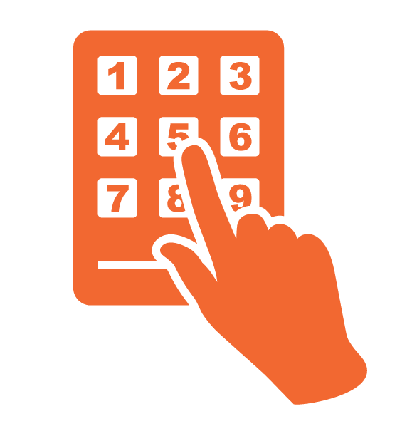
How To Create Unique Passwords
  Make it meaningful to you and no one else
  Create passphrases with special characters
  Avoid items that can be easily discovered in social media profiles or pictures
FlyME2theMoon!
Notes:
Narrator:
It is important to use combinations in the creation of your passwords, or even passphrases, like the words to a favorite song. flYME2theMoon! Would be a good example of a passphrase that is easy to remember and hard to crack!
Don’t create a PIN with your birthday (or relative’s birthday) or anniversary date – any event you celebrate with a post on social media and can be easily discovered by a cybercriminal. The same goes for creating a password that uses your children’s or pet’s names if you post pictures with their names on social media all the time.
The attention to passwords creation can really make a difference. The difference between one weak password and one strong password could deter or facilitate a cyberattack!

Slide 10
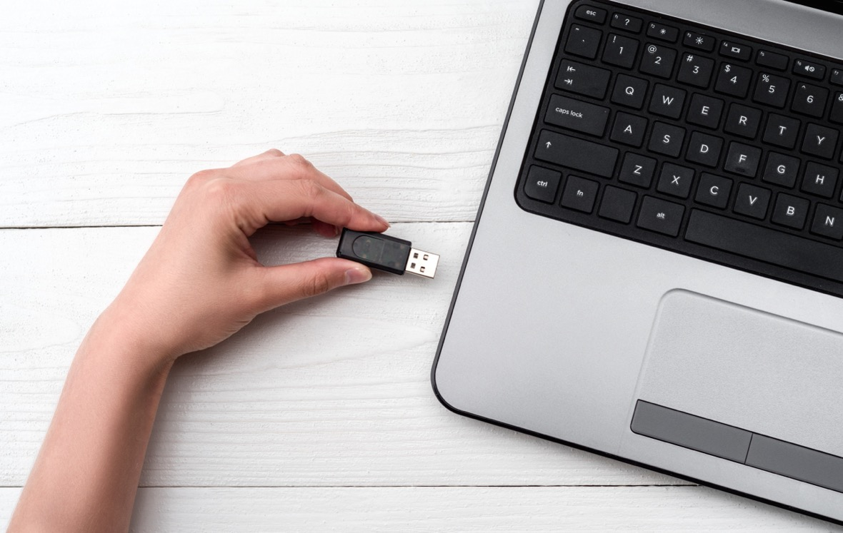
Data Loss – USB Drives
USB Drives or “thumb” drives
Universal Serial Bus
Transmits data in and out of a device
Inexpensive and portable for carrying data
So, what is the risk you might ask?
Notes:
Narrator:
Let’s talk about USB drives and potential data loss.
We more than likely have used a USB drive at one time or another. What exactly is a USB Drive as it relates to data? USB is the abbreviation of Universal Serial Bus that is a technical specification of input and output interface. Basically, it can transmit data in and out of a device.
USB drives, sometimes known as thumb drives, are small, readily available, inexpensive, and portable, so they are popular for storing and transporting files from one computer to another. However, these same characteristics make them appealing to attackers.
Cybercriminals have taken advantage of the simplicity of USB drives to replicate company logos or even hand them out at organizational conferences, embossed with logo and all! Moral of this story is always on guard when using USB devices - know the source because the capabilities this small device holds, in most cases beneficial, may not be when a malicious actor has a different intent!

Slide 11

USB Drives
Tips to avoid data loss
Do not plug an unknown USB drive into your computer
Be sure to use passwords and encryption if you do use a USB Drive
Avoid using your personal USB drives on your organization’s computers.
Keep your computer software up to date
Verify if you have security software on your computer – if unsure ask your Manager or IT administrator
Disable “Autorun” on your computer
Notes:
If you do use USB drives, here are some key tips to protect your system and data –
Do not plug an unknown USB drive into your computer. If you find a USB drive, give it to the appropriate authorities (a location's security personnel, your organization's information technology [IT] department, etc.). Do not plug it into your computer to view the contents or to try to identify the owner.
Take advantage of security features. Use passwords and encryption on your USB drive to protect your data, and make sure that you have the information backed up in case your drive is lost.
Keep personal and business USB drives separate. Do not use personal USB drives on computers owned by your organization, and do not plug USB drives containing corporate information into your personal computer.
Disable Autorun. The Autorun feature causes removable media such as CDs, DVDs, and USB drives to open automatically when they are inserted into a drive. By disabling Autorun, you can prevent malicious code on an infected USB drive from opening automatically.
Use and maintain security software, and keep all software up to date. Use a firewall, antivirus software, and anti-spyware software to make your computer less vulnerable to attacks, Also, keep the software on your computer up to date

Slide 12

Let’s Play Jeopardy!
CATEGORY
Cybersecurity
Facts
$1000
For $1000, the answer is..
$4.11
Million Dollars
Notes:
According to the IBM report of all industries across the country, accidental data loss or lost device ranked 6th in terms of average cost and frequency of data breaches by this attack vector. This evidence alone demonstrates the critical need to be so aware of the importance of device and data security.
But let’s have a moment of levity and see if you can provide the correct answer to this Jeopardy question!!
Narrator read slide as the host playing the game:
Category is:
For $1000
The correct answer is:

Slide 13
Let’s Play Jeopardy!
For $1000:
The Question is:
What is the potential monetary impacts to an Organization after an incident involving loss or theft of equipment or data?
Notes:
Narrator read slide:

Slide 14
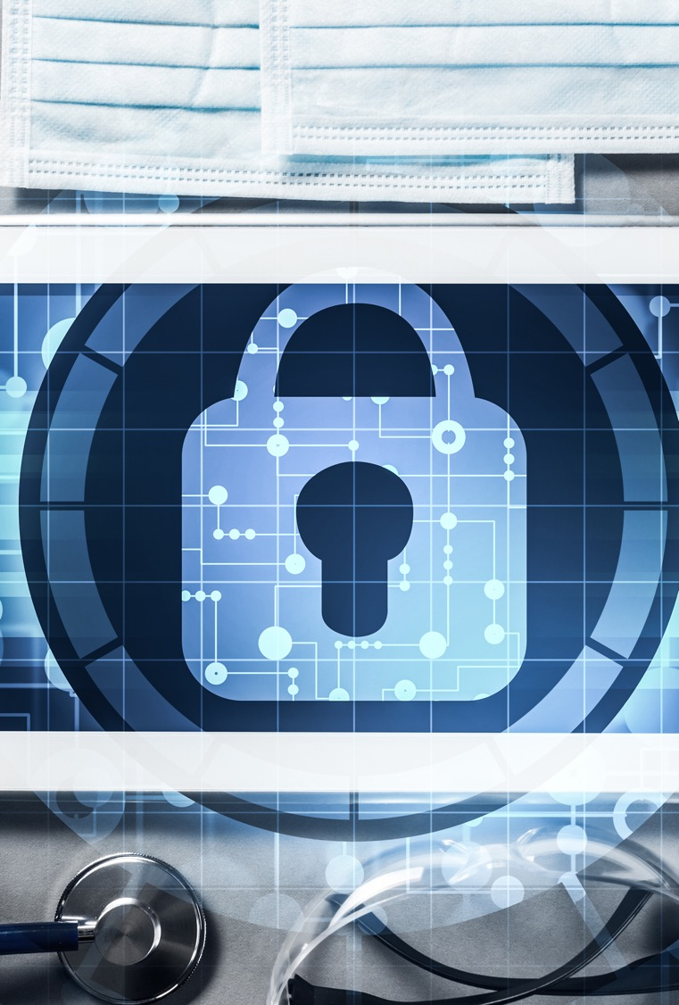
What are the impacts?
Loss or theft of equipment equals a breach of sensitive patient and facility information involving PHI. This is the cyber risk we need to avoid at all costs!
Cyber risks can threaten:
Your ability to use your system and access information
Organization’s reputation
The bottom line
Potentially your organization's survival
Notes:
Narrator:
By now, I am certain you understand the importance of data security and what happens with any loss or theft of data or equipment. In this field, we must do everything to protect patient safety, including their medical information. Cyber risks can threaten your own individual ability to use your computer system and access information.
It can impact your organization's reputation leading to a loss of trust
It can certainly impact the bottom line financially – the costs of cyber impacts in this scenario are huge as you can imagine. Even after you recover a loss device the data may have been erased and completely lost. This results in business disruption and compromised patient safety and may require notification to patients, applicable regulatory agencies and/or the media.
And lastly, the overall survival of your organization, depending on the size of the impact and the capability of the organization to rebound from the costs incurred.
As it relates to this topic of “loss or theft of equipment or data, imagine how the loss of data would directly apply to all four of these concerns?
The role we all play to be aware of and react to cybersecurity threats ensures a safer environment for ourselves and our patients.

Slide 15
What you need to know
To help prevent loss or theft of equipment, make sure you know your organization’s policy on removing equipment from the workplace by asking these questions:
Can I travel with my equipment?
Can I take my equipment offsite to work remotely? Do I understand how to access my organization safely?
Can I use USB or other portable storage devices?
Is the information on the computer or storage device encrypted?
How can I use a secure VPN and secure, password-protected Wi-Fi, to log into the network and work?
Notes:
Narrator:
Its important to know your organization’s policies and procedures regarding to your equipment. We realize that not everyone has a laptop or tablet that you are allowed to take away from the office, but many of you do have that privilege. For those who don’t, there are still many polices and procedures everyone should be familiar with at your workplace.
What are the rules for traveling with equipment?
Can I work remotely/offsite and how do I access sensitive information?
Can I use USB device for storage?
Do I know how to encrypt sensitive data?
And what about a secure network to transmit that data, especially if I am in a remote setting? What is the VPN or virtual private network, how do I use it, what password/access information do I need ahead of time?

Slide 16

Knowledge Check #2
It is important to be aware of your organization’s policies on traveling with equipment or taking equipment home to work remotely.
Notes:
Narrator
Read Knowledge check as stated:

Slide 17

Answer to Knowledge Check #2
Now, let’s look at some “phi
The correct answer is True!
You should always verify your organization’s policies associated with the use of your equipment outside of your office location. This will ensure you are not exposing your laptop or mobile devices to unknown risks accessing unsecure networks.
Notes:
Narrator
Read answer to the Knowledge Check

Slide 18
Best Practices
How can you protect your devices and data?
Know where your mobile devices are at all times
Never leave them unattended or unlocked
Encrypt sensitive data
Be aware of your surroundings
Strong passwords are critical and never share your password
Report any loss of equipment or suspicious activity on your systems immediately!
Notes:
Narrator
Here are a few recommendations to follow related to how you can prevent loss or theft of equipment or data! Always be sure to ask your Manager or IT supervisor/administrator for your facility or organization’s policies and keep them close by your workstation as a reference.
Narrator boxes as outlined

Slide 19
Summary
Loss or theft of equipment or data can have significant long-term implications that will far outweigh the cost to replace the device
Follow all system instructions regarding secure passwords, updating software etc.
Take immediate action if an event occurs! Contact your Manager or Security or IT professional for guidance
Provide as many details as possible related to the incident
Notes:
Narrator:
Lets review these key summary tips:
The most important thing you need to know is this:
As soon as you realize that your device or equipment has been stolen or misplaced, your supervisor and IT security professional should be notified immediately so appropriate measures can be taken to safeguard the data saved on your device or equipment.
IT security support staff or similar point of contact should be notified when a work device or equipment has been misplaced, lost, or stolen. The data saved on them are now compromised and susceptible to unauthorized access, dissemination, and use. This is a serious cyber breach and should be handled by trained IT security professionals.

Slide 20
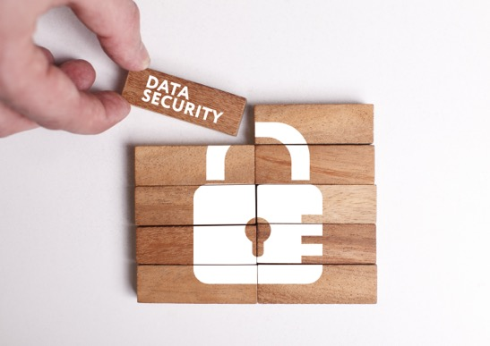

Congratulations! You have completed this session on Loss or Theft of Equipment or Data.
In this session you’ve learned:
The definitions and meaning behind loss or theft of equipment or data
The impacts to healthcare and your organization
The role you can play in prevention
Best Practices
We all play a key role in keeping our organization safe. We are the first line of defense so always remember:
CyberSafety is Patient Safety!
Notes:
Narrator:
Read slide as is, provide direction to complete the Certificate of Completion per your organization policy.

Slide 21
