Slide 1

Ransomware
Not if, but when
Plan
Prepare
Protect
Notes:
NARRATOR:
Welcome to the 405d knowledge on demand program, “Ransomware - It’s not IF, but WHEN.”
In this course you’ll learn how to plan, prepare and protect your organization from the threat of ransomware attacks.

Slide 2
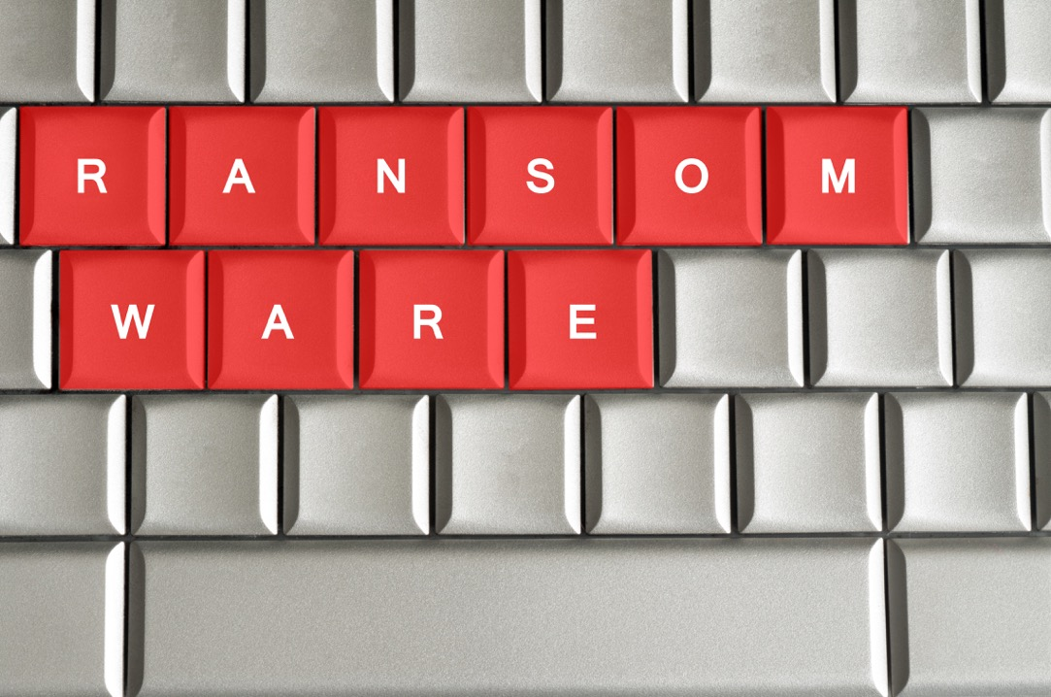
Welcome
Ransomware
What is Ransomware?
Facts and Resources
What are the threats? Impacts?
Best Defense is Good Offense
Lessons learned
Knowledge Checks
Notes:
Narrator:
This presentation is intended to provide a greater awareness of the cyber serurity threat known as Ransomware. We will provide facts, specific healthcare data and emphasize the importance of a having a "good defense" against this threat.
The following learning objectives will be presented to include:
Defining Ransomware and its impacts
Recognizing warning signs to avoid these attacks
Reviewing best practices and lessons learned
Throughout the session, there will be knowledge checks to assist in reinforcing the learning.
Let’s begin this discussion today.

Slide 3

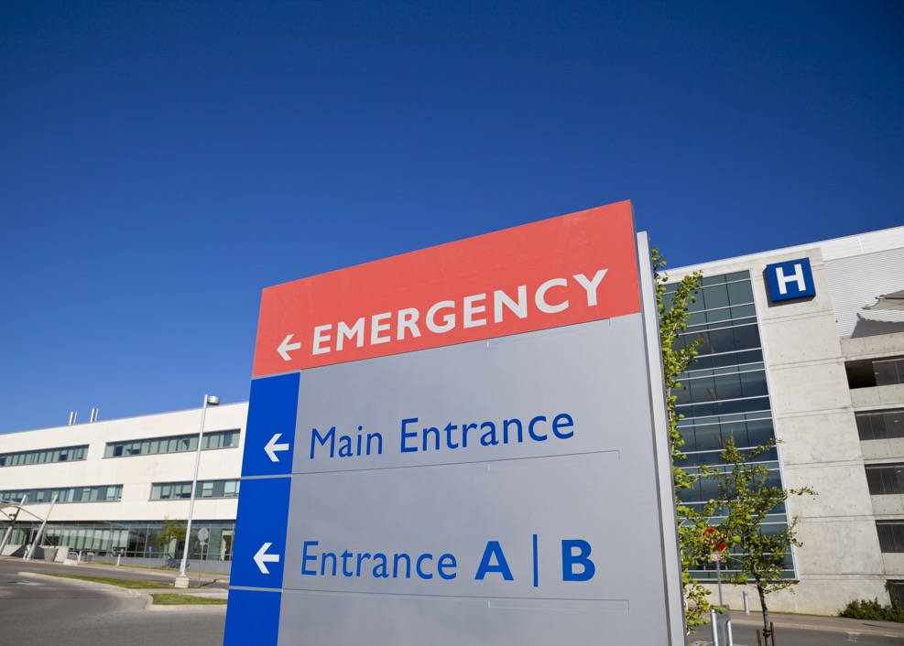
Ransomware Actual Event
It was approaching midnight on Sunday and the head of IT at a Florida hospital had a problem.
The emergency room of this100-bed facility called to report that it couldn't connect to the charting system that doctors use to look up patients' medical histories.
Notes:
Narrator
Read slide as is--this is an actual event that happened
Let’s take a look at an actual ransomware incident that hit a hospital in Florida.
It was approaching midnight on Sunday and the head of IT at a Florida hospital had a problem.
The emergency room of this100-bed facility called to report that it couldn't connect to the charting system that doctors use to look up patients' medical histories.
The hospital IT director soon realized that the charting software, which was maintained by an outside vendor, was infected with ransomware and that he didn't have much time to keep the computer virus from spreading.

Slide 4

Ransomware – Actual Hospital Event
A Florida hospital IT director, soon realized that the charting software, which was maintained by an outside vendor, was infected with ransomware and that he didn't have much time to keep the computer virus from spreading.
The hospital shut down its computer systems on his advice.
"If we hadn't stopped it, it probably would've spread out through the entire hospital," the IT director said. Hospital staff ditched the electronic records and reverted to pen and paper to keep the hospital running and organized, he said, but patient care wasn't disrupted.
Notes:
This is a true story.
The hospital shut down its computer systems on his advice.
"If we hadn't stopped it, it probably would've spread out through the entire hospital," the IT director said.
Hospital staff ditched the electronic records and reverted to pen and paper to keep the hospital running and organized, he said, but patient care wasn't disrupted - this time.
These attacks happen more often perhaps than we realize. Most incidents like this one at a local hospital are not breaking news on the national networks. Unlike like the Ransomware attack of July 2021 in Texas that shut down the oil pipeline from Texas to NJ that every network covered extensively for days. However, that does not make this crisis any less critical or crippling.
Thankfully, this IT Director reacted immediately and knew exactly what he had to do to prevent this attack from spreading throughout the entire hospital. There was a plan in place, and he took the action necessary at that moment in time.

Slide 5
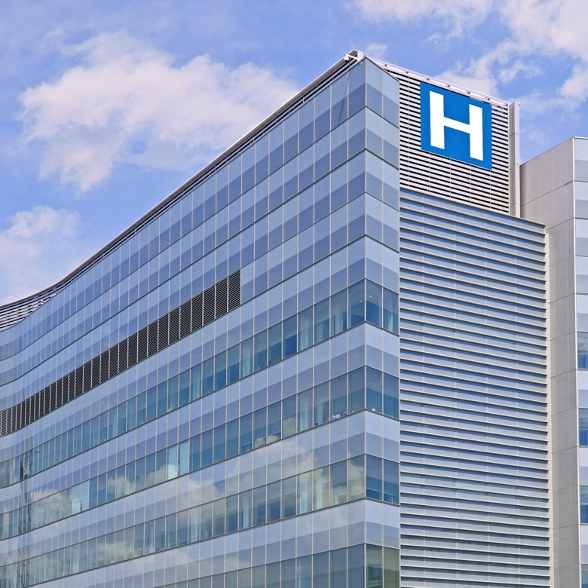
Ransomware disruptions have cost the sector millions of dollars
Attackers hold hospitals or physicians' data hostage until the money is paid
This causes interruption of patient services putting patients lives at risk
Notes:
FACILITATOR NOTES:
This hospital in Florida is just one of several dozen health care organizations across the US that have had to battle ransomware attacks since the coronavirus pandemic began. The disruptions have cost the sector millions of dollars and prompted urgent calls to hospitals from federal officials to be wary of cybercriminal groups.
In ransomware schemes, attackers hold a hospitals or a physician’s data hostage until money is paid, interrupting services, and putting patients’ lives at risk.

Slide 6
What is Ransomware?
“Ransomware poses a threat to you and your device but what makes this form of malware so special is the word "ransom. Ransomware is extortion software that can lock your computer and then demand a ransom for its release.”
In simple terms:
Malware gains access to the device
Depending on the type of ransomware, either the entire operating system or individual files are encrypted.
A ransom is then demanded from the victim.
Notes:
Narrator:
Cybersecurity threats to health care organizations and patient safety are real. Health information technology, which provides critical life-saving functions, consists of connected, networked systems and leverages wireless technologies, leaving such systems more vulnerable to cyber-attack. Recent highly publicized ransomware attacks on hospitals, for example, necessitated diverting patients to other hospitals and led to an inability to access patient records to continue care delivery.
In 2016, a bold new threat arrived on the scene: This new threat was called Ransomware.
So, lets start by defining ransomware in the most simplistic terms. Read the definition in quotes at top of slide.
Narrator read quote in first paragraph –
The malware will gain access to the device, perhaps affecting the entire operating system or individual files, leaving them inaccessible to you without paying the ransom the cybercriminal as demanded.
What does this look like in a real world scenario? In one instance a rural hospital attack required them to replace its entire computer network after a ransomware cyber-attack froze the hospital’s electronic health record (EHR) system. Doctors were unable to review their patients’ medical histories or transmit laboratory and pharmacy orders. Officials were unable to restore essential services and could not pay the ransom for the return of their system. After consultations with the Federal Bureau of Investigation and cybersecurity experts, hospital officials made the difficult decision to replace the entire system
And unfortunately, these attacks are not going away. In fact, the hackers are finding new and devious ways to infiltrate the health care system. We are going to discuss this in more detail and why understanding how attention to the smallest detail in an email can have huge benefits to your organization.

Slide 7
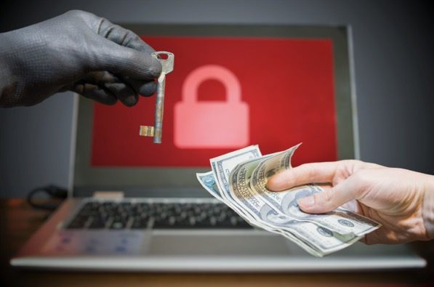
Ransomware Facts
Ransomware incidents can severely impact business processes and leave organizations without the data they need to operate and deliver mission-critical services.
Malicious actors are getting more sophisticated with their tactics even pressuring victims for payment to stop the release of the stolen data
Ransomware demands in some cases exceeded
$1 Million Dollars!
Ransomware incidents have become more destructive and impactful in nature and scope.
Notes:
Narrator:
The facts surrounding the impact of a ransomware attack are staggering. They can severely impact business processes and leave organizations without the necessary data they need to operate and deliver their services. Imagine the countless services provided everyday in your healthcare organization and then imagine them coming to an abrupt halt!
These malicious actors have been improving their tactics over time and they pressure their victims for payment by threatening to release the stolen data and even publicly naming the hospital and even individuals as a secondary form of extortion.
They make it their full- time job to find new and clever ways of impacting the network to collect valuable data and hold companies' hostage.
Imagine, the demands in some cases have exceeded $1 Million dollars!!!!!
Lastly, we know that these attacks have become more destructive in nature and scope.
While this may all sound intimidating, it is important to be aware of the number of organizations within the Dept of Health and Human Services and other partner Federal Agencies, whose prime focus is cyber security awareness, prevention and education.

Slide 8
Federal Resources
HHS HC3 – Health Sector Cybersecurity Coordination Center
https://www.hhs.gov/about/agencies/asa/ocio/hc3/index.html
CISA - Cybersecurity and Infrastructure Security Agency
https://www.cisa.gov/
HHS OCR – Office for Civil Rights
https://www.hhs.gov/ocr/index.html
Notes:
Narrator:
Here’s just a few of the key resources to share:
The Health Sector Cybersecurity Coordination Center better know as HC3, was created by the Department of Health and Human Services to aid in the protection of vital, healthcare-related controlled information and ensure that cybersecurity information sharing is coordinated across the Health and Public Health Sector (HPH).
The Office for Civil Rights -The HHS Office for Civil Rights, or OCR, enforces federal civil rights laws, conscience and religious freedom laws, the Health Insurance Portability and Accountability Act (HIPAA) Privacy, Security, and Breach Notification Rules, and the Patient Safety Act and Rule, which together protect your fundamental rights to nondiscrimination, conscience, religious freedom, and health information privacy.
You can find all you need to know about HIPPA and individual rights under the law on their website listed on this screen.
Lastly, our partners at CISA provide invaluable support to both federal and private sector organizations in all aspects of cybersecurity awareness planning and prevention.
They have dedicated an entire section of resources that addresses just Ransomware that can be found at this link: wwww.cisa.gov.
This is serious business! Don’t make the mistake of thinking that your practice, no matter how small, is not a target for indiscriminate cyber-attacks. Malicious actors will always exist. Whether you are a small-practice physician or the Chief Information Security Officer of a large health care entity, your job is to make it difficult for these attackers to succeed

Slide 9
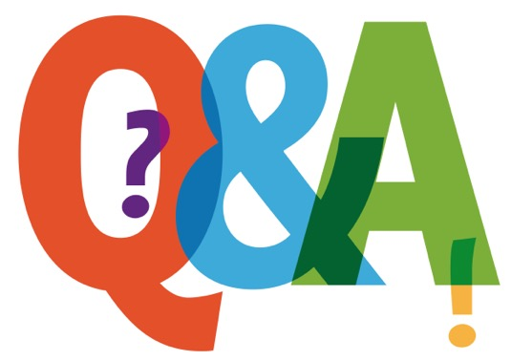
Knowledge Check #1
Ransomware’s defining characteristics include:
It immediately shuts down your computer system
It attempts to deny access to user’s data
It is a type of malicious software
Causes your font type to appear skewed or blurry
Notes:
Narrator:
Let’s Review
Here is your first Knowledge Check:
Ransomware’s defining characteristics include:
It immediately shuts down your computer system
It attempts to deny access to user’s data
It is a type of malicious software
Your font size appears skewed and blurry

Slide 10
Answer to Knowledge Check #1
The correct answer is: C
Ransomware if a type of malicious software that attempts to deny access to a user’s data, usually by encrypting the data with a key known only to the malicious attacker.
Great job!!
Notes:
The correct answer is: B
Ransomware if a type of malicious software that attempts to deny access to a user’s data, usually by encrypting the data with a key known only to the malicious attacker.
If you got this one correct, Great job. But no worry if you did not. We are going to continue learning more about how you can become more aware of the risks and dangers and how you can be ready if a malicious attack happens to you!

Slide 11
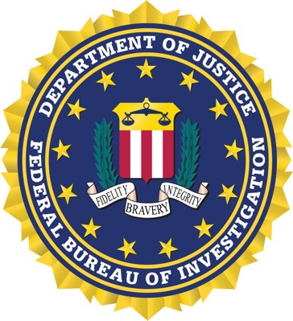
Impacts to Healthcare - Facts
FBI IC3 – Internet Crime Complaint Center (IC3) March 2022
The FBI pays a lot of attention to the topic of Ransomware
In 2021 one incident during the height of the pandemic exposed the files of nearly 1.6 million health system patients!
This health system shut down the IT Network and employed employee health record downtime procedures
Notes:
Narrator::
We’ve just discussed what ransomware is and described some of the specific facts that define ransomware and how it works.
The FBI, HHS CISA and other federal agencies as, you can imagine, pay a lot of attention to this topic.
In one notable instance from 2021, a ransomware incident exposed the files of nearly 1.6 million health system patients.
These sensitive patient files were available on the dark web which was being reported on by media for several months - before the Indiana-based healthcare organization publicly acknowledged the exposure.
Although health system officials commended the quick action staff took to shut down the IT network and deploy EHR downtime procedures, the attack came just as Indiana’s COVID-19 caseload was surging, creating further strain on staff and patients at the worst possible time.
**************************************

Slide 12

Impacts to Healthcare - Facts
FBI IC3 – Internet Crime Complaint Center (IC3) March 2022
“Healthcare Sector Faced Most Ransomware Attacks Last year”
The IC3 confirmed the Healthcare sector faced the most ransomware attacks in 2021
148 complaints files were healthcare ransomware attacks
In 2021, the IC3 observed 847,376 complaints and recorded $6.9 billion in losses. These numbers have been steadily climbing over the last five years.
Phishing emails remain at the top of the list for initial infection vectors for ransomware
Don’t get hooked!
“Ransomware tactics and techniques continued to evolve in 2021, which demonstrates ransomware threat actors’ growing technological sophistication and an increased ransomware threat to organizations globally,”
Notes:
Narrator::
We have just discussed what Ransomware is and talked about some of the specific facts that define ransomware and how it works.
Narrator:
The FBI IC3, which stands for Internet Crime Complaint Center, just issues a report March 24, 2022 whose headline read: “Healthcare Sector Faced Most Ransomware Attacks Last Year”. That’s a headline to make you stop in your tracks if you work in the healthcare industry! Here is a few highlights from that report:
The IC3 confirmed the Healthcare sector faced the most ransomware attacks in 2021
148 complaints files were healthcare ransomware attacks
Next highest came from finance with just 89!
Phishing emails remain at the top of the list for initial infection vectors for ransomware
Don’t get hooked
Phishing emails are in our control to manage. So you ask, what's my role? If the FBI has stated that phishing emails are in the top three of ways the ransomware actors are trying to “hook” us, then we have to be ever so vigilant with every email that crosses our system
Reviewing every small piece of your email that looks suspicious to you, that contains information that asks you to respond immediately or elicits a sense of urgency are two of the most common hooks in the game. Also review the “URL” f rom the sender. Hover over that URL, see if it matches the sender. Report it immediately, do not click any links or respond.
Still think you can’t make a difference?
Let’s continue to show you how!!

Slide 13
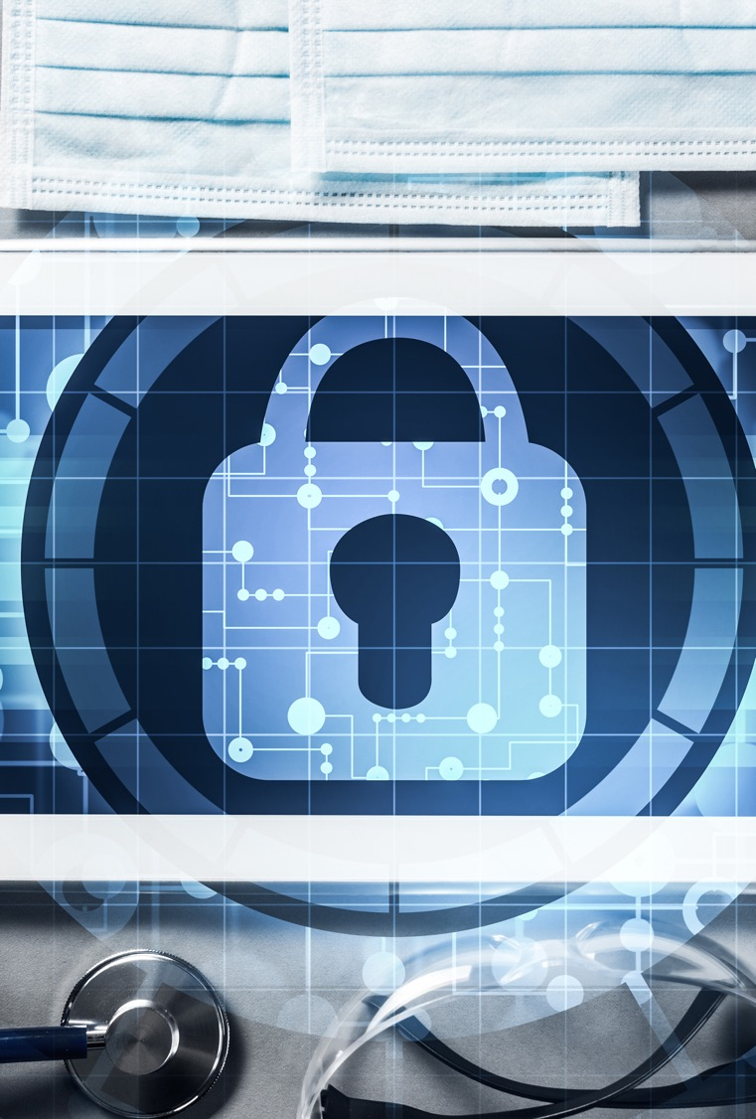
Impacts to the organization
Monetary impacts to the organization
Potential impact to the organization's reputation
Permanent closures of organization, especially the smaller ones
Loss or deleted files
Delayed or cancelled patient care: procedures, testing, surgery, etc.
Systems shut down, potentially crippling network systems and forcing manual transactions were possible
Notes:
Narrator:
What are the impacts of a ransomware attack you might ask? At the beginning of this presentation, we shared a real story from a Florida Hospitals experience and how the quick action of the IT administrator saved the day. But here are the major impacts of ransomware to the healthcare sector:
Narrator read the bullets clearly
The first could be monetary impacts. The organization's reputation could be at risk. In some situations, tehse attacks could lead to the permanent closure of the organization, especially the smaller ones.
There certainly could be permanent loss and/or deletion of files.
Patient care could be affected, such as the cancellation of procedures, testing or even surgery.
And finally, complete system shut down, potential crippling the network systems and forcing the staff to convert to manual operations, as in the example from the Florida hospital we shared at the beginning of this video.

Slide 14

IBM 2022 Report
Cost of Ransomware attacks
$4.54 Million
Notes:
https://healthitsecurity.com/news/fbi-ic3-healthcare-sector-faced-most-ransomware-attacks-last-year
We will now review the most recent IBM 2022 Report that details the costs associated with Ransomware attacks
The costs of Ransomware and destructive malware attacks are extraordinary! But there is a bit of good news.
Compared to last year, ransomware
breach costs have declined slightly, from USD 4.62 million
to USD 4.54 million.
However, the frequency of ransomware breaches has increased — from 7.8% of breaches in the 2021
report to 11% in the 2022 study.

Slide 15
What you can do!
Change your passwords when prompted to do so​ and never share your password!
Phishing emails – this is the top choice for an initial cybercriminal attack ​
Hackers have expanded their tactics by using QR (Quick Response)Codes​
Report incidents to your Manager or IT administrator​
​
Hover over the email URL – be sure you know who the sender is – if not report it​
Software updates​
Check your mobile settings to activate QR code confirmation feature​
Install an app that previews QR codes before launching​
Notes:
Narrator::
We just reviewed scenarios about the dangers, risks and costs associated with a ransomware attack. What can you do specifically, to be on guard and not become the next victim.
Phishing remains the primary method to start a ransomware attack. The cybercriminals take advantage of the "human element" and include information that is either personal, or a statement of action, using words like, please respond immediately, or your action is required.
How many of you have received an email with that language? I think we all have at one point or another. Hover over the URL – be sure you the URL matches the sender and never click a link inside a message if you are unsure. Report suspicious emails immediately to your manager or IT administrator.
Hackers also love to use new technology, like QR codes. QR codes or Quick Response codes became very popular during the pandemic, especially for the restaurant industry. They replaced their hard copy menus to reduce cross contact and contamination with QR codes that conveniently displayed their menu on your phone. The malicious actors use this new "backdoor option” to execute their ransomware attack.

Slide 16

Knowledge Check #2
True or False?
According to the IBM Report of 2022, the frequency of Ransomware breaches has increased from previous years.
Notes:
Narrator:
Read question as is:

Slide 17
Answer to Knowledge Check #2
Now, let’s look at some “phi
The correct answer is: True
7.8% of breaches in the 2021 increased to 11% in the 2022 study.
Notes:
Narrator:
Read answer and discuss if desired.

Slide 18
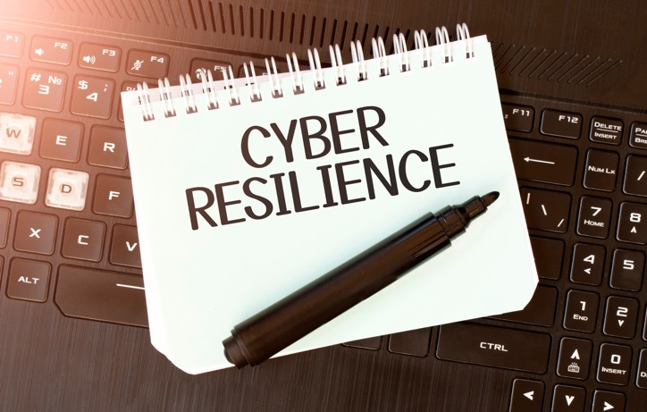
Best Defense is a good Best Offense
Self- Check List
Be on the lookout for any updates you receive from your office administrator or IT administrator.
Install updates whenever prompted to do so.
Are you aware of your organization's incident response plan?
Is there training I should be aware of to understand my organization’s security policies?
Do I have an emergency contact list?
Staying Resilient
Most ransomware attacks are sent in phishing campaign emails
Stay alert when any email asks you to enter your credentials.
Notes:
Narrator:
Most ransomware attacks are sent in phishing campaign emails asking you to either open an attachment or click on an embedded link.
Be sure you know how to identify these phishing e-mails! Stay alert when any email asks you to enter your credentials. Some good questions to ask to stay vigilant are:
Install updates whenever prompted to do so by your department or organization.
Is there training I should be aware of to understand my organization’s security policies?
Am I aware of the organization's incident response plan?
Do I have an emergency contact list handy to report suspicious activity or to ask for help? For example, for my IT Administrator or Practice Manager?

Slide 19

Lessons Learned
DO NOT PAY THE RANSOM
Important things to remember for overall system security
Keep Calm and Patch On
Backing Up Is Your Best Bet
When in Doubt, Report it Out
Always Authenticate
Prepare and Practice Your Plan
Your Data Will Be Fine if It’s Stored Offline
Secure Your Service Message Block (SMB)
Paying Ransoms Doesn’t Pay Off
Last but not least….
Good Cyber Hygiene Habits Keep Your Network Healthy
Cyber Safety Is
Patient Safety
Notes:
Narrator:
Here is an important list of lessons learned from our federal partners:
Narrator read through the bullet list, emphasizing the last but not least line:
Do not pay the Ransom – Paying a ransom doesn’t pay off
Try to keep calm and “patch on”
Backing up your systems is always a secure and safe bet
When in doubt, report!!
Always authenticate
Prepare and Practice your plan within your organization
Your data will be fine if you can store if offline
Secure your service message block (SMB)
Good Cyber Hygiene habits keep your network healthy!

Slide 20

Knowledge Check #3
The impacts of a ransomware attack can be crippling to include monetary, permanent closures of especially smaller organizations, deleted files and even patient procedures and testing being cancelled.
What can you do as an individual to help prevent this from happening?
Participate and complete any required training
Be aware of the network security firewalls in place
Have your IT administrator contact information easily accessible
All of the above
Notes:
Narrator:
Read slide as is – instruct to click to navigate to next slide

Slide 21
Answer to Knowledge Check #3
Now, let’s look at some emails and see if you can spot the red flags? Remember, the hackers are trying to trick you, so don’t fall for that hook!!
The correct answer is D – All of the above
Each of us play a critical role in patient care and patient safety. Remember,
Cyber Safety is Patient Safety and together we can protect our organization and the patient data we are entrusted to secure.
Notes:
Narrator:
Read slide as is

Slide 22

Summary
The Ransomware threat is real! And it could cripple your healthcare system and make the data vulnerable and accessible
Awareness and attention to detail is critical since ransomware often begins with a phishing email
Understand your organization's network and security capabilities
Keep handy the contact information of your IT professionals or administrators
If you are concerned you have been hacked, or something within your computer system seems off, contact your IT professionals immediately – quick action is critical!
Notes:
Narrator:
We have covered a lot of ground in our discussion on Ransomware today.
The Ransomware threat is real! And it could cripple your healthcare system and make the data vulnerable and accessible to anyone - at a price!
Awareness and attention to detail is critical since ransomware often begins with a phishing email
Understand your organization's network and security capabilities
Keep the contact information handy for your IT professionals or administrators, and…
If you’re concerned you might have been hacked, or something within your computer system just doesn’t seems right, contact your IT professionals immediately – quick action is critical!

Slide 23
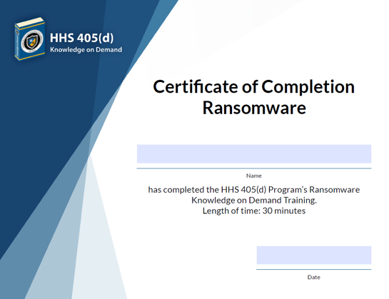
Congratulations! You have completed this session on Ransomware
This video has provided an awareness of:
What is Ransomware?
What’s are the threats? Impacts?
Best Defense is Good Offense
Best Practices
Helpful Resources:
HC3
https://www.hhs.gov/about/agencies/asa/ocio/hc3/index.html
CISA
www.cisa.gov/stopransomware
HHS 405d
www.405d.gov
We all play a key role in keeping our organization safe. We are the first line of defense so always remember:
CyberSafety is Patient Safety!
Notes:
Narrator:
Read slide as is, provide direction to complete the Certificate of Completion as applicable to your organization.

