Slide 1
Social Engineering
HHS 405(d) Program

Slide 2
Welcome
Social Engineering
YOU make a difference
Impacts to Healthcare
What is Social Engineering?
What You Need to Look For
Let’s Go Phishing
Lesson Scenarios and Knowledge Checks
Internet and Email Checklist
Notes:
Narrator:
This PowerPoint presentation provides an introduction to the topic of Social Engineering, what this is, and how you can protect yourself and your organization from serious security threats. It will introduce the various forms of social engineering such as phishing and smishing attempts and how to recognize them. Most importantly, it will outline the role we all have in protecting the data we have at our fingertips. We are the first line of defense, so let’s be sure we know how to recognize a cyberattack and how to report it to your designated IT personnel.
This intent of this presentation is to increase your awareness of the topic of Social Engineering in the following areas:
Recognize your role in in protecting against cyber attacks
Define Social Engineering and the various methods of cyber attacks
Identify the warning signs of a social engineering attempt
Reduce the risks by reporting suspicious activity immediately
Narrator: you can decide how you want to use the Knowledge Checks included in this presentation intended to assist in reinforcing the learning. You could use these in a polling option if online learning, as an example or just ask the questions out loud in a meeting/classroom environment. A Certificate of Completion will be provided for your use if you choose to use them to document this event.
Let’s begin!

Slide 3

Cyber Safety is Patient Safety
You play a key role!
Notes:
NARRATOR
Health care organizations and every employee that works within them are committed to providing the very best for their patients. The thought of risking patient safety to a cyber-attack is one we should want to avoid at all costs. We know the value of heath care records continues to go up each and every year and that is the #1 reason why cybercriminals want to get into your workspace and your network.
At first glance, if you don’t work in computer or network security, you might ask yourself, “what can I do about this”? Most users don’t see themselves as part of IT security; they feel that this should be left to an “IT Department”. Well I can assure you, you have a major role in protecting the data and systems. Over the course of the next 30 minutes, we will define social engineering, what you can look for and most importantly, the actions you can take to report them. We will also be highlighting recent Health Care statistics and the associated threats.
When we look at the THREAT details, there is often one common theme that stands out amongst all of them beyond technology and that is the human element. The human element is now understood to be an intrinsic component of cybersecurity because a weakness here can be the greatest vulnerability to a breach.
So, let’s start this journey of learning more about social engineering and how you and I can truly make a difference.
At the end of the day, you are the first line of defense! Effective cybersecurity is everyone’s responsibility,

Slide 4
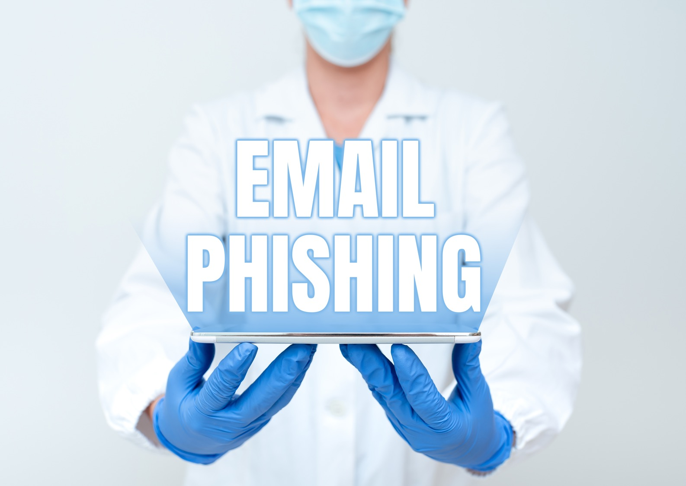
Impacts To Healthcare
$10.10 Million
average total
cost of a breach
in healthcare
Hacking was responsible for 75% of all reported incidents in 2022.
Hacking incidents include phishing/email attached and ransomware/malware incidents
86% of all breached patient records in 2022 were caused by hacking!
1 medical record sells for $250!
Notes:
Narrator:
Let’s begin with the impacts to Healthcare. What are they you might ask? What do I need to be aware of?
Here is the most recent data from two top reports: the IBM 2022 Cost of a Data Breach Re port and the 2022 Breach Barometer Protenus report.
​
The average total cost of a breach in healthcare increased from
USD 9.23 million in the 2021 report to USD 10.10 million in 2022, an increase of 9.4%.
Think of the terabytes of data that a hospital or medical practice stores - all of the PII (Personal Identifiable Information) and PHI –(Personal Health Information). The black market for healthcare records is real – malicious actors even get “star ratings” from their ‘customers’ for their services just like on eBay! A single medical record - which can contain a person’s Social Security and driver’s license numbers, gender, race or ethnicity, and birth date – sells on the black market for around $250.
Hacking was responsible for 75% of all reported incidents – hacking incident include phishing/email attached and ransomware/malware incidents
86^ of all breached patient records in 2022 were caused by hacking!
These statistics clearly outline the importance of protecting patient data and enforcing cybersecurity basics to prevent the next data breach.

Slide 5

Effective cybersecurity is a shared responsibility
So, what are the threats? What can I do?
Did you know that…
12
Consecutive years Healthcare had the
highest cost per breach
Notes:
NARRATOR
Most health care personnel are experts at identifying and eradicating viruses in patients, not computers. Cybersecurity has expanded the scope of patient wellness to include protecting the technology, networks, and databases that enable uninterrupted and accurate patient care. This includes securing computer systems, protecting data and training personnel to be cyber-vigilant to protect against these threats to healthcare and patient safety.
And Healthcare once again had the highest incident cost per breach. Healthcare breach costs have been the most
expensive industry for 12 years running, increasing by 41.6% The average total cost of a breach in healthcare increased from
USD 9.23 million in the 2021 report to USD 10.10 million in 2022
Still think you can’t make a difference?
Let’s continue to show you how!!

Slide 6
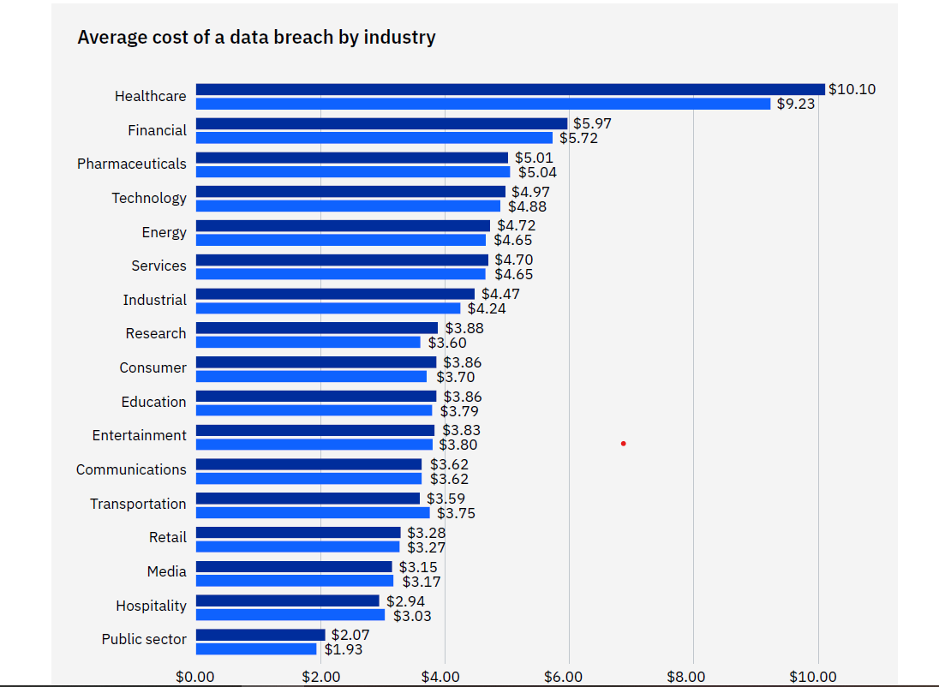
Source: IBM Security, Cost of a Data Breach Report 2022
Notes:
NARRATOR
This graphs outlines the average cost of a data breach by industry.
As you can see, Healthcare once again is at the top of the charts and had the highest incident cost per breach above all other industries.

Slide 7
The number of patient records compromised in data breaches us up 46% from just two years ago.
BreachBarometer 2022
Notes:
NARRATOR
This is a graph of the total number of breached patient records from 2016-2022
The number of patient records compromised in data breaches us up 46% from just two years ago
Data from the Breach Barometer Protenus 2022 Report release February 2023

Slide 8
What is Social Engineering?
How does it work?
Social engineering is a form of psychological manipulation that tricks users into making security mistakes or giving away sensitive information. It relies on human error instead of vulnerabilities in software and operating systems by exploiting human emotions.
Examples:
Email sent by a ‘friend’
Message relaying a troubling story about someone you may know
The message says ‘time is running out’
Offer seems too good to be true
Message offers help you never requested
Sender cannot confirm their identity
Human error is much less predictable, making it harder to detect and block than attacks on hardware or software.
urgency
supervisor
authority
help
Social Engineering
access
password
experience
system
phishing
security
Notes:
NARRATOR
So let’s discuss the “how” behind these breaches so we can do everything we can to reduce and hopefully eliminate the next one!
And we will start with understanding Social Engineering!!
Yes, human errors happen! We need to understand who we are dealing with when it comes to these cyber attackers! They work hard at fooling us, it’s their job. So, we must do our job to defend ourselves and our organizations.
Social Engineering as defined is a form of psychological manipulation that tricks users into making security mistakes or giving away sensitive information. And it does this by relying on human error, instead of possible software and operating system vulnerabilities. These malicious actors use email, text messages and voice messages to get your attention.
Some examples of those human emotions that cyber attackers like to manipulate which causes us to make a grave mistake include
Emails from an alleged “friend”
Emails that portray a sense of urgency, such as take action now, or time is running out
Sometimes the message seems just too good to be true
And it might offer help that you never actually asked for.
These are all major clues that there very well may be something very suspicious with this email and you should take precaution.
Do not make the mistake of thinking that your practice, no matter how small, is not a target for indiscriminate cyber-attacks. Malicious actors will always exist. Whether you are a small-practice physician or the chief information security officer (CISO) of a large health care entity, your job is to make it difficult for these attackers to succeed. They will use our vulnerabilities to attack the larger organization!

Slide 9

Common Clues in Social Engineering
Trick you into:
Revealing information
Installing malware
It relies on human error instead of vulnerabilities in software and operating systems.
Notes:
NARRATOR
An attacker may seem unassuming and respectable, possibly claiming to be a new employee, repair person, or researcher and even offering credentials to support that identity. However, by asking questions, he or she may be able to piece together enough information to infiltrate an organization's network. If an attacker is not able to gather enough information from one source, he or she may contact another source within the same organization and rely on the information from the first source to add to his or her credibility.
It doesn’t matter who they’re impersonating, their motivation is always the same – extracting money or data. Whether you use the modern-day terminology or opt for longer-standing classifications (like conning, hustling, and swindling), the result is the same. Scammers aren’t afraid to tell lies – and they often get what they want just by asking for it.
Social engineers take advantage of human tendencies to be open and trusting. All successful social engineering attacks have one thing in common: someone believed something they shouldn’t have.!!!

Slide 10
Knowledge Check #1
Hackers like to use Social Engineering Techniques to trick you into making a security mistake. They do this by adding these words or phrases to a message. Select the answer from the list below.
Sending a message with a sense of urgency.
Including wording that says “quick, time is running out”
Mentioning an illness of a family member or friend
All of the above
Notes:
Narrator:
Read question and answers, ask audience to answer via random or polling if in online meeting setting.

Slide 11

Answer to Knowledge Check #1
The correct answer is:
D – All of the above
The terminology used such as “urgency” and references to your family or friends are all attempts to trick you!
Notes:
Narrator:
Read answer – discuss as needed

Slide 12
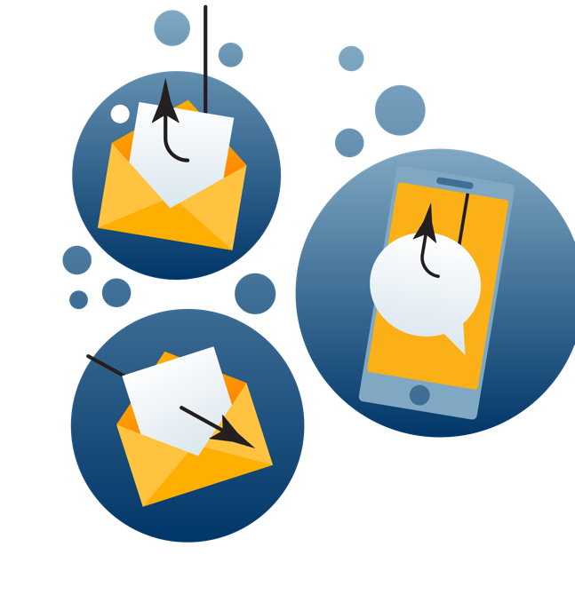
What is the most common form of Social Engineering?
Phishing
A form of Social Engineering that uses email or malicious websites to solicit personal information by posing as a trustworthy organization.
Spear Phishing
A form of Social Engineering that targets a narrower audience, hence the spear. These attacks are more coordinated.
Notes:
NARRATOR
Phishing is the most common form of social engineering.
E-mail phishing is an attempt to trick you, a colleague, or someone else in the workplace into giving out information using e-mail. An inbound phishing e-mail includes an active link or file (often a picture or graphic). The e-mail appears to come from a legitimate source, such as a friend, coworker, manager, company, or even the user’s own email address.
Attackers typically impersonate legitimate institutions like governments, hospitals, or large corporations to convince individuals to relinquish the data. For example , an attacker may send a fraudulent e-mail from a cyber-attacker disguised as an IT support person from your patient billing company. The e-mail instructs your employees to click on a link to change their billing software passwords. An employee who clicks the link is directed to a fake login page, which collects that employee’s login credentials and transmits this information to the attackers. The attacker then uses the employee’s login credentials to access your organization’s financial and patient data
A phish is simply put, the practical application of social engineering. Using manipulation techniques, an attacker hopes to persuade you to act in a way that benefits them.​
Another type of phishing to be aware of is called Spear Phishing.
Spear phishing usually targets a narrower audience—hence the spear.​
Typically, these attempts target someone with authority.​
These attacks are more coordinated. They usually involve detailed intel gathering on the target subject and are not attempted until things like job title, email address, and specific information about their role are obtained.
And there’s a good reason for this.
If I can gain access to the account of someone with authority at a business or hospital, I can more easily manipulate people into helping me out.
And have you heard about Baiting – As the name suggests, USB drives or CD’s are simply left around for any individual to notice. It might be in the lunch room, or coffee room, or perhaps in a conference room. Some malicious actors are so bolden that they have actually handed them out at a cybersecurity conference as a “give away”, branded with the name of the event right on it!.. But beware….these infected USB drives left in an area where employees are around, where out of simple curiosity may pick it up and put it in their computers…it might contain malware!! USB device usage should be restricted. Many people aren’t aware how this happens and it all seems so innocent, right????

Slide 13

Phishing scams have similar traits!
Contain a call to action – click, open, reply
Conveys a sense of urgency
Contains odd aesthetic features, like blurry or overstretched images and misspellings, capitalization, and other grammatical errors
Remember the definition of social engineering- they are trying to manipulate you into making security mistakes.
Notes:
NARRATOR
Be on the lookout for phishing scams. Be familiar with their traits:
If the grammar and spelling look odd or incorrect, that is a flag..
​
If the graphics appear stretched or blurry, or the message is asking you to immediately reply, or uses words like “this is critical”, be on guard. ​
​
These are all human manipulation strategies, trying to instill fear and concern. ​
​Take your time, read the message, and if it doesn’t look right or feel right, don’t click on any links, and report it immediately. We will be discussing reporting a little later in this video.

Slide 14
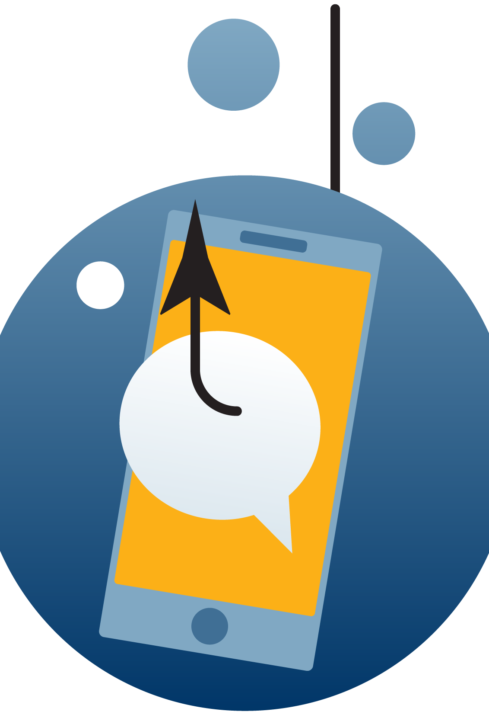
Be alert for Smishing attacks
Smishing is a form of social engineering that exploits SMS, or text, messages.
Text messages can contain links to such things as webpages, email addresses or phone numbers that when clicked may automatically open a browser window or email message or dial a number.
Users are much more trusting of text messages, so smishing is often lucrative to attackers phishing for credentials, banking information and private data.
Notes:
NARRATOR
Since we all can’t seem to put our cell phones down, the cybercriminals know they have another way to try to trick you– via a text message
Most of the 3.5 billion smartphones in the world can receive text messages from any number in the world. Many users are already aware of the dangers of clicking a link in email messages. Fewer people are aware of the dangers of clicking links in text messages.
81% of Americans text regularly.
Over 6 billion texts are sent every day.
80% of professionals currently use text for business purposes.
Users are much more trusting of text messages, so smishing is often lucrative to attackers who are phishing for credentials, banking information, health information, and private data.
Most smishing attacks work like email phishing. The attacker sends a message enticing the user to click a link or asks for a reply that contains the targeted user’s private data.
The information an attacker wants can be anything, including :
Online account credentials.
Private information that could be used in identity theft.
Access to patient data that could be sold on the black market.
The smisher may use your name and location to address you directly. These details make the message more compelling. The message then displays a link pointing to an attacker-controlled server. The link may lead to a credential phishing site or malware designed to compromise the phone itself. The malware can then be used to access the user’s smartphone data or send sensitive data silently to an attacker-controlled server.

Slide 15
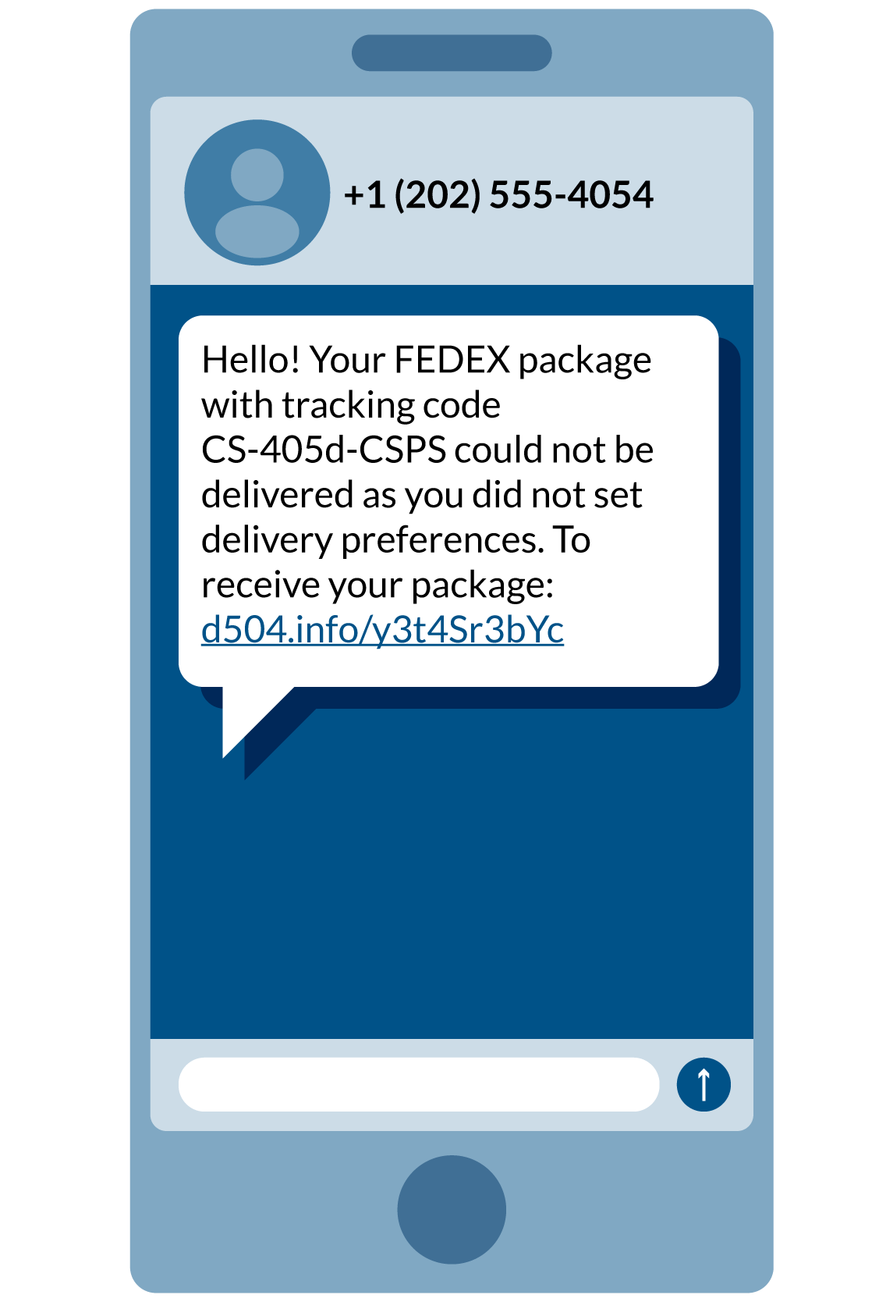
5 Smishing examples
Your bank account is locked.
A message claiming to be American Express about your credit card activity.
The "you won a prize and click here to get it” attack.
The it must be fake, but it is also funny attack.
Unusual account activity message that says you need to click to secure your data.
Notes:
NARRATOR
How many of you have received a message like this, from a delivery carrier or perhaps a retail store that you have shopped with before. Maybe Amazon is confirming the delivery of a package, and you ask yourself, “I don’t recall ordering anything in the last few days from Amazon? That simple pause, asking yourself that question could be a life saver!
Here are five top smishing examples to be on the lookout for. Most of them sound real, it’s not a surprise that people fall for them. Whether it is a financial institution or Apple telling you to “secure your information” proceed with caution.
The urgent your bank account is locked type of smishing message. This one pretends to be from US
The urgent message about your credit card smishing attack. In this case, claiming to be from American Express.
The you won a prize and click here to get it smishing attack. In this case, it claims to be from Walmart. This is tempting because you've taken some of those surveys printed on your receipt. Did you finally win money you never thought you would?
The it must be fake, but it is also funny smishing attack. In this case, pretending to be from Amazon. You haven't taken this survey yet, but if you do, you're going to be a winner! (Actually, the hackers win.)
The unusual account activity smishing message that says you need to click to secure your information when just the opposite is true. (Do not click!)
Since we are usually multi-tasking while we are on our phones, it is far too easy to click that link when Apple tells you to reset your password. But take your time, read the message carefully. Go to the website of the company making this request or call them on the phone to verify the message accuracy. It will be worth the few minutes of your time to investigate the message before you simply “click” and potentially create a much bigger issue for your privacy and security. Proceed with caution is always your best bet!
https://www.proofpoint.com/us/threat-reference/smishing
https://www.secureworld.io/industry-news/5-smishing-attack-examples-everyone-should-see

Slide 16
2022 Top 2 Attack Vectors across all industries
Do you want to take your best guess what the #2 most common attack across all industries might be?
#2: Phishing — 16%
$4.91
million dollars
Annual cost of phishing
Notes:
NARRATOR
In summary we discussed Phishing and Smishing to gain a greater understanding and awareness of how those two attacks manifest themselves.
Lets close with a few more interesting facts we can learn from the IMB 2022 Breach Report—
The most common initial attack vector in 2022 was stolen or compromised credentials, responsible for19% of breaches. -
In 2022 the most frequent initial attack vectors were
(1) stolen or compromised credentials, 19% of breaches
(2) phishing,16%
(3) cloud misconfiguration, 15%. These were the same top 3 in 2021 report as well!
The second costliest initial attack vector was phishing with a cost of $4.91 million dollars!
So, I think you are beginning to see the picture we are trying to paint for you. Phishing is costly to any organization and the cybercriminals are working hard each and every day to come up with new and innovative ways to trick us!
We have to be on guard to avoid falling victim to these scams and help to reduce the significant costs as a result of phishing threats. Continuing education and awareness will always be our best defense!

Slide 17
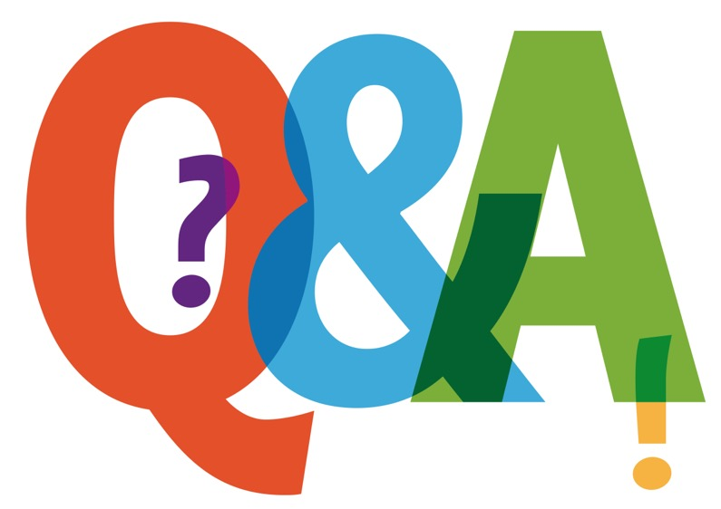
Knowledge Check #2
From the list below, which is a form of Social Engineering that uses email and malicious websites to solicit personal information by posing as a trustworthy organization?
Smishing
Spam
Phishing
Telemarketing
Notes:
Narrator:
Read slide as is with question and answer choices

Slide 18
Answer to Knowledge Check #2
The correct answer is:
C – Phishing
the most common form of Social Engineering..
Notes:
Narrator: Read as is, answer question as needed

Slide 19
Recognizing and Reporting Phishing
What to ask?
There are 4 things to check when you suspect an email might be a phishing attempt.
Sender is Unfamiliar or Unexpected
Do you recognize the sender?
Are you expecting a message from this person?
Does the subject seem normal?
Message Doesn’t Look Right
How’s the use of English?
Is everything spelled correctly?
Is it formatted like a regular email?
Check ‘From’ Address
Does it look legitimate?
Double click the ‘From’ to inspect
  Both should look similar
  CustomerService@amazon should not read “bob@scamyou.org”
Inspect All Links and Attached Files
Hover over the link or attachments and ask yourself these questions:
  Does the displayed URL make sense?
  Contact the company directly to confirm they sent the email
Notes:
NARRATOR
The first step you can take to avoid phishing attacks is learning to recognize them. There are 4 things to check:
1. Check to see if the sender is familiar, or if you’re expecting an email from this person or organization.
Suspicious emails may begin with an unfamiliar sender name or odd wording in the subject area
Many times the message doesn’t look right. Look for added wording, such as:
‘Dear customer’ instead of your name
Awkward use of English language
Spelling errors
If you still aren’t sure about the email, check the ‘From’ address.
Hover over the ‘From’ field or double-click the name. The actual sender’s address will appear.
The sender’s displayed name should look familiar; for example, the @**** should match the way its displayed normally
(CustomerService@amazon should not read ‘bob@scamyou.org’)
4. Anytime you receive an email with a link or an attached file its ALWAYS a good idea to take a moment to check
Hover the cursor over the link or attached file; the URL of the web page associated with the link or attached file is displayed
The URL should ‘make sense’ by matching or being similar to the sender’s information
Contact the company directly to confirm that they sent the email requesting said information before clicking any links.

Slide 20
Recognizing and Reporting Phishing
When to ask?
Who to ask?
The best time to familiarize yourself with your organization’s policies for reporting a suspicious e-mail is when you begin employment. Whenever you receive an e-mail that sounds too good to be true or that you were not expecting, verify it before opening it!
Check with colleagues to find out whether they received the same phishy email. You can always seek the guidance of your IT security support team or similar point of contact. Talk to them to find out whether your account is protected with the proper security filters to ward off unwanted junk mail.
Notes:
NARRATOR
A good "best practice" it to do your homework and have a plan in place so you know what to do and who to contact not “if” you get a phish, but WHEN!
Being prepared will ensure that you take immediate action and know who to contact.
Know your organization's policies regarding reporting any suspicious email when you begin a new job, or even change departments.
here may be a different contact based on where you work, especially in a large healthcare facility.
And rely on your colleagues by asking them if they happened to receive a similar email. Always check with your local IT administrator or Practice Administrator for guidance if you are unsure.
There are resources available to you, so keep those names and phone numbers handy so you can address any issue immediately if it should occur.

Slide 21
Knowledge Check #3
There are a few clues to watch for if you suspect the e-mail you received is suspicious. Select all that apply.
The email contains several grammar and spelling errors.
The “from address” does not match the “sender” name.
All of the above
You do not recognize the senders name or email.
Notes:
Narrator: Read question and answers as is

Slide 22
Answer to Knowledge Check #3
The correct answer is:
D – All of the above
Each of those are important clues to help you determine the safety of that message!
Notes:
Narrator: read answer as is and discuss as needed

Slide 23

Exercises
Now, let’s look at some “phishy” emails and see if you can spot the red flags?
Remember, the hackers are trying to trick you, so don’t grab that hook!!
Notes:
NARRATOR
We will now get to review some phishy emails, all of them actual attempts that people received. Let's see if you can spot the red flags!
Remember, the hackers are trying to trick you, so don't grab that hook!!

Slide 24
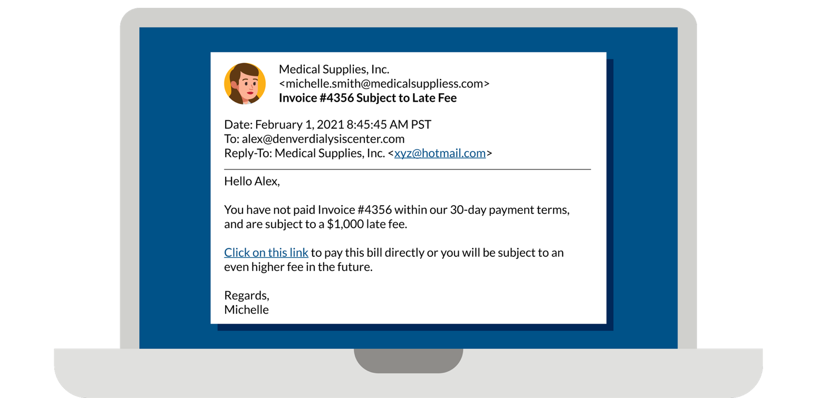
Would you have taken the hook on this email?
Internal Employee
Impersonation of Michelle Smith
Impersonation
Display name spoofing
Malware links
Simple requests in email body
Notes:
NARRATOR
Here we have a email from "Medical Supplies, Inc.". Sure looks like the real thing. The topic is relevant, I know Michelle, she works at my company and my name is Alex, so I guess this message was intended for me, right??? Lets look again!
Wrong, this is a perfect example of how cybercriminals can impersonate fellow employees, managers and even IT officials, all to make it seem perfectly normal and makes it so easy for you to click away!
Animate arrows to highlight the elements of the graphic to review in detail.
Look at the steps this criminal took to fool you.
Impersonation of an internal employee
Had you correct name and email address
Topic was relevant, Medical supply company
Oh, yes and the infamous “link in the email message”…..CLICK HERE Alex?

Slide 25
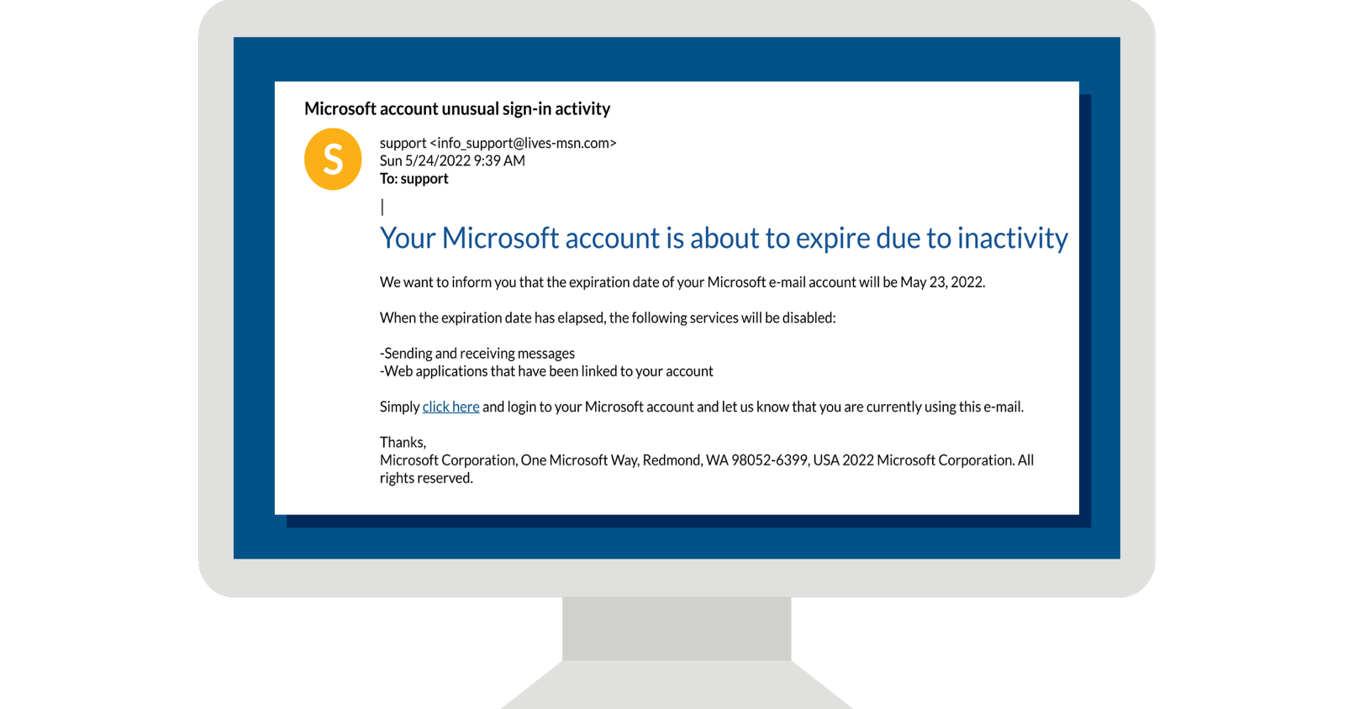
Would you have taken the hook on this email?
Notes:
NARRATOR
How about this email from Microsoft.
Let’s take a close look at this email message.
First of all, do you currently use Microsoft to conduct your day to day work? If so, there is the first hook they thought you might fall for. If you do not, then there is your first flag!!
If not, then there is your first red flag!
But wait, lets look closely at that sender address? – info_support@lives_msn.com ---WHAT is that? lives-msn.com, that certainly doesn’t look like an MSN URL does it?
And the date and time, Sunday, 939 AM….the “to” simply says “SUPPORT”…..there are far too many red flags here, this cybercriminal obviously isn’t aware how cybersafe you are!!
Just the heading alone should tip you off that this just doesn’t seem right! STOP right where you are and report this one immediately!

Slide 26
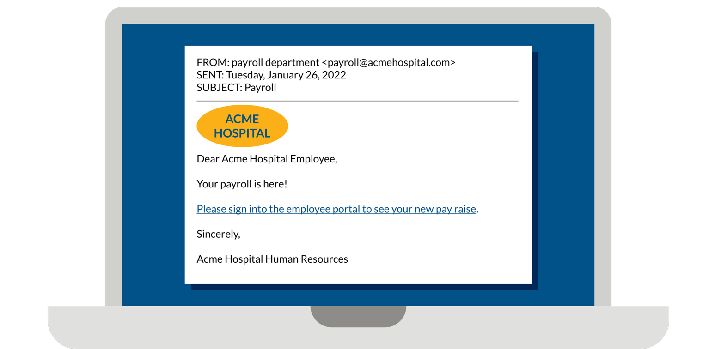
Ok, this is a simple request! Pay raise? Where do I click?
Notes:
NARRATOR
Now if this didn’t get you interested, I don’t know what would!! A pay raise? Who wouldn’t want to learn more about that in my employee portal, right?
EXACTLY what the cybercriminal thought you would say!! Tugged at your heart strings and made this personal and exciting. Just click here to see your new pay raise. HMMMMMM
You could certainly start by verifying the from address to be sure that is correct, that would be your first clue.
And would it be addressed to “Acme Hospital Employee”…is everyone getting a raise? Yikes!!
Again, take your time, review your messages when they come into your inbox. That one click might cost your organization more than any raise you might have deserved!!

Slide 27
Phishing Checklist
Check your cyber pulse
Don’t recognize the sender?
Not expecting an attachment or email?
Does ‘From’ address match message?
Does this invoke a sense of urgency?
Don’t recognize the destination URL?
Is this standard internal procedure for IT issues?
Is this website secure? (https://)
Is this email asking for your login credentials?
Is there bad grammar or spelling?
Is the greeting/signature generic or lack contact information?
Notes:
Well, we hope that over the course of this presentation, you have been enlightened about social engineering, phishing and all the steps YOU can take to prevent the next cybercriminal from being successful!
This simple checklist can also be found on the 405d Program website under the title of “Social Engineering, Job Aid”.
www.405d@hhs.gov/Knowledge on Demand
“Knowledge on Demand” tab at the top bar then “Job Aid”.​
These are all very important and simple actions you can take to prevent and even eliminate the next potential attack within your organization.
As we said at the beginning, YOU do make a difference, we all do. If each of us do our part, collectively we can keep our network and our organizations as safe as possible from cybercriminals gaining unauthorized access to our systems and data. Remember, Cybersafety IS patient safety.
Thank you for sharing part of your day with us!

Slide 28
Congratulations—you have completed this session on Social Engineering!
In summary, this video has presented:
The important role we all have in being cybersafe
Understanding Social Engineering and the various methods of cyber attacks
Identifying the warning signs of social engineering attempts
The impacts to healthcare systems and patient care
The importance of timely reporting of anything suspicious
We all play a key role in keeping our organization safe. We are the first line of defense so always remember:
Cyber Safety is
Patient Safety!
Please be sure to visit the KOD page under “Social Engineering” to print the “Job Aid "with the checklist we just discussed.
Notes:
NARRATOR:
Read the slide as us, highlighting your steps to fill out the Certificate of Completion.

Slide 29
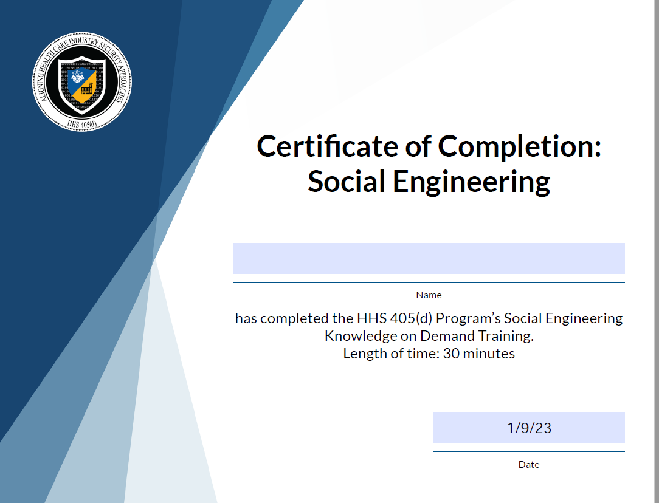
Notes:
NARRATOR
PLEASE FILL IN THE APPROPRIATE FIELDS:
NAME
DATE
SELECT "CONTROL P" TO PRINT THIS CERTIFICATE ON YOUR LOCAL PRINTER AND BE SURE TO PROVIDE A COPY TO YOUR MANAGER/SUPERVISOR FOR RECORD KEEPING.

